Slide 1

New Developments in
David Baird Vanessa Cave
david@vsni.co.uk vanessa@vsni.co.uk
1 December 2022
AASC2022 Inverloch
Notes:
We’re delighted show you today some of the new features in our latest release: Genstat 22, and also to provide you with a glimpse of some of the things being worked on for Genstat 23 – scheduled for release in the first half of next year.

Slide 2
New Genstat 22/3 features
GLMM enhancements
Equivalence, non-inferiority and non-superiority tests
Censoring in REML & Poisson GLM/GLMM/HGLM models
New graphics types
Command insertion menus
Reshaping data
More information read in from Excel
Two new skew distributions added

Slide 3
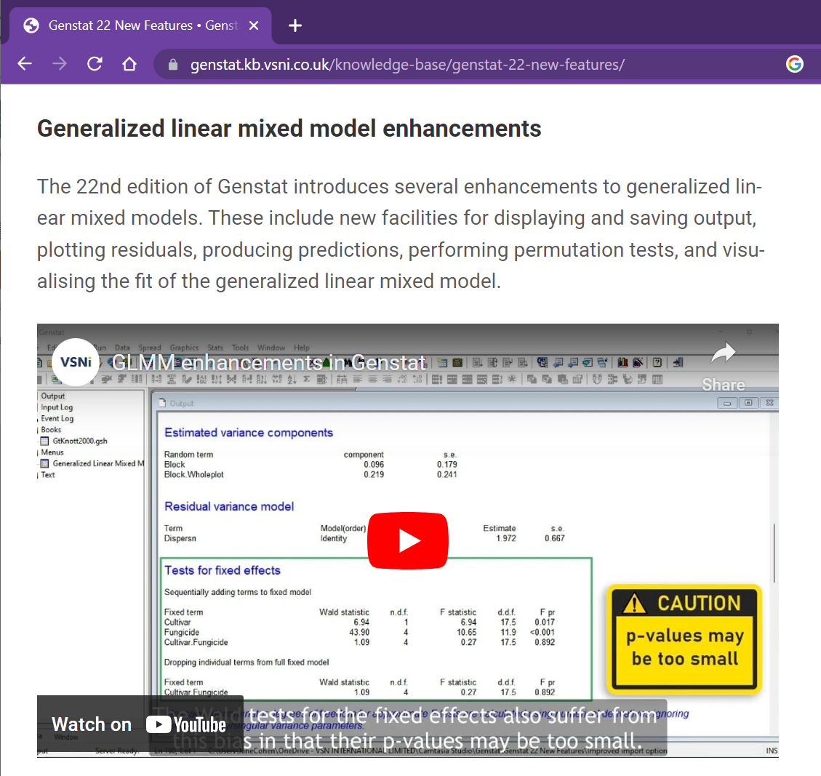
GLMM enhancements in 22nd Ed.
Aim: to provide a more thoughtful and complete analysis
New GLMM facilities for:
Displaying and saving output
Plotting residuals
Visualising the fit of a binomial GLMM (separation plots)
Producing predictions
Performing permutation tests for fixed terms
Calculating likelihood tests to assess random terms
Notes:
One of the major enhancements to Genstat 22 was the addition of new facilities for generalized linear mixed model analysis, aimed at providing a more complete and thoughtful analysis.
Genstat 22 provides new facilities for displaying and saving output, plotting residuals, visualising the fit of a binomial GLMM, producing predictions, performing permutation tests for fixed terms and calculating likelihood tests to assess the random terms in a GLMM.
And just a wee plug for the Genstat tutorial videos, there’s one available on this topic. We do keep adding to the video library, so please do check it out from time to time, particularly after a new release. And also, if there is a topic you would like us to cover, please do let us know.

Slide 4
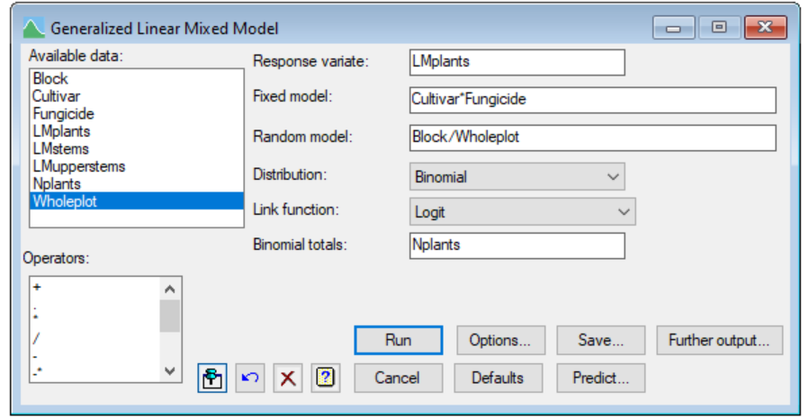
GLMM enhancements in 22nd Ed.
Underpinned by new and/or extended menus
Enhanced
Enhanced
New
New
Notes:
In addition to new procedures, the GLMM menus have been considerably updated
The Options menu now includes additional options for displaying output and controlling the REML algorithm.
There’s a much more comprehensive save menu
And newly added Predict and Further output menus.

Slide 5
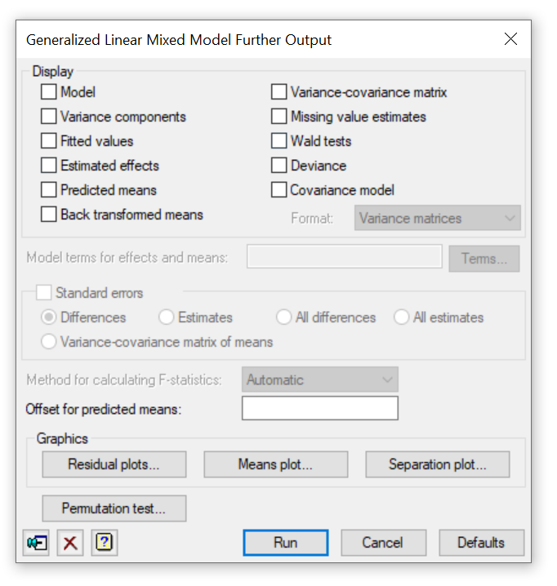

GLMM enhancements in 22nd Ed.
Notes:
Today I’m just going to concentrate on two of my favourite new GLMM features, both of which are accessible via the Further Output menu:
Permutation tests and Separation plots

Slide 6
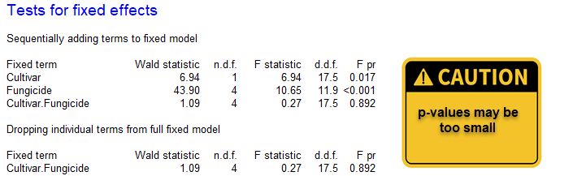
Permutation tests for fixed effects
Variance components from a GLMM tend to be underestimated
Thus…
The standard errors for the fixed effects may be too small
The Wald and F test statistics may be too large (i.e., their p-values too small)
Especially problematical for binary and small data sets
Notes:
A problem with GLMMs is that the estimates of the variance components are generally smaller than the true values. The Wald / F tests for the fixed effects also suffer from this bias in that their p-values may be too small. Therefore, we need to be cautious when interpreting the p-values from these tests.
This is especially problematical when analysing binary data or small data set (but also can be an issue for binomial data with small binomial totals and Poisson data with small counts)

Slide 7
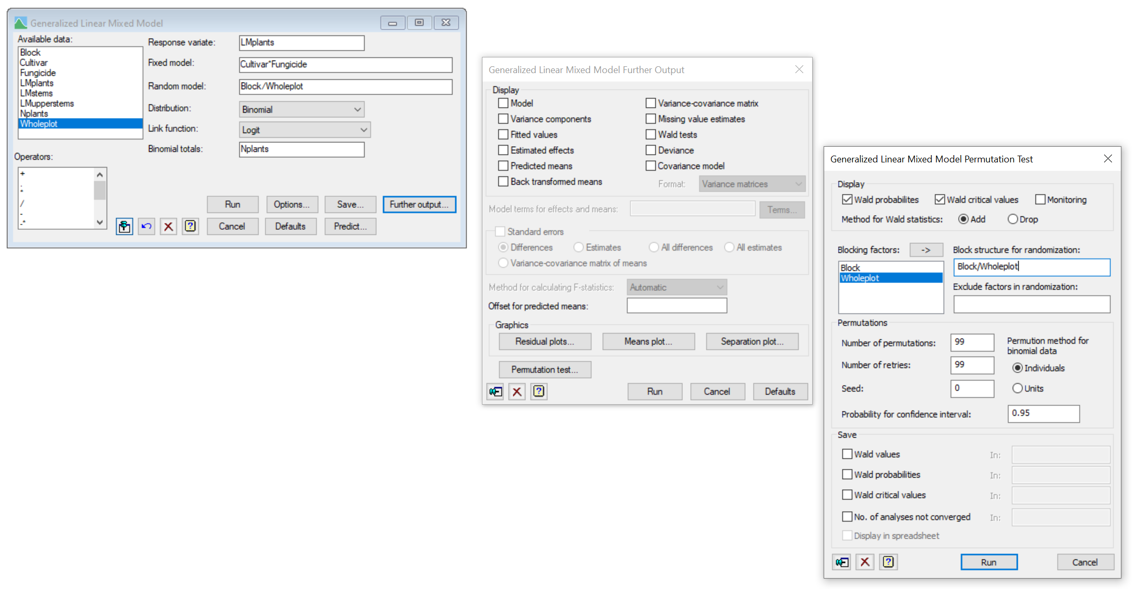
Permutation tests for fixed effects
Permutation tests provide an alternative, more reliable, way to assess the fixed effects
Implemented in the procedure GLPERMTEST
Accessible from the GLMM Further Output menu
Notes:
Permutation tests help overcome this problem by providing an alternative, more reliable, way to assess the fixed effects, and Roger’s implemented them in a procedure called GLPERMTEST, which you can of course use directly, or for your convenience, access from the GLMM Further Output menu

Slide 8
Permutation tests for fixed effects
Procedure GLPERMTEST…
Forms random permutations of the response
Analyses the permuted data sets
Obtains the Wald statistics from the permuted data
Estimates from the set of permuted Wald statistics…
critical values
from the quantiles
test probabilities
given by the proportion of Wald statistics, including the original statistic, greater than
or equal to the original statistic
Wald statistics from permuted data
Original Wald statistic
Notes:
So how does GLPERMTEST work – well It forms random permutations of the response, analyses those data sets, and records their Wald statistics.
The distributions of the Wald statistics can be estimated by the sets of statistics obtained from the analyses of these permuted data sets.
And thus test probabilities for the original Wald statistic and critical values can be estimated

Slide 9
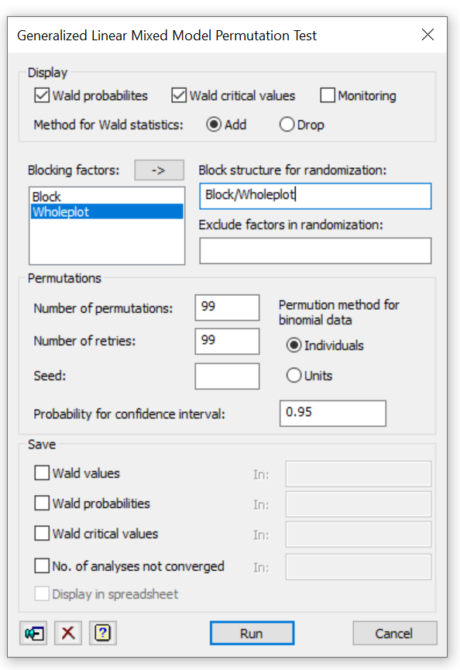
Permutation test menu
Wald tests for either…
sequentially adding terms to the model
or
sequentially dropping terms from the full model
Notes:
There’s a couple of things I want to point out on the menu
The Method for Wald statistics radio buttons controls the type of Wald statistics to use - either those from sequentially adding fixed terms to the model, the default, or those from dropping fixed terms from the full model.
If Drop is selected, tests will only be made for terms which are not marginal to other terms in the model.

Slide 10
Permutation test menu
Controls how the randomization is done for designed experiments
For example: Block/Wholeplot
first randomize the levels of Block
then randomize the levels of Wholeplot within the levels of Block
Notes:
If the data are from a designed experiment, the field highlighted here lets you preserve the blocking structure when randomly permuting the data.
For example, by entering Block with Wholeplot into the field Genstat will first randomize the levels of Block, then randomize the levels of Wholeplot within the levels of Block

Slide 11

Permutation test menu
For binomial data can either permute the:
number of successes from the NBINOMIAL observed individuals
or
binary outcomes from each individual
Notes:
And finally, for Binomial data you can either permute the number of "successes" obtained from the observed number of individuals
OR
expand the data set to the level of the individuals, and permute these - this is the recommended method and thus the default

Slide 12
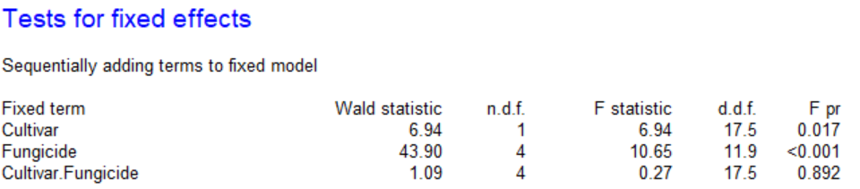

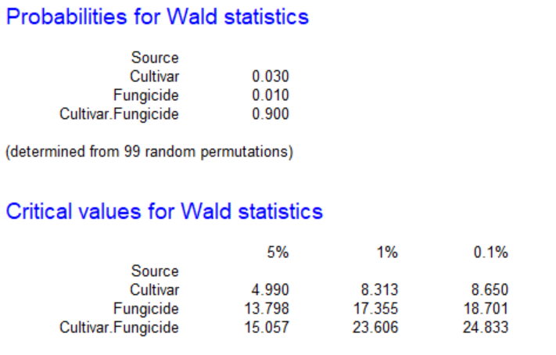
Example: GtKnott2000.gsh
Binomial data from a split-plot trial of Cultivar and Fungicide
Original tests
Permutation tests
Chi pr
0.008
<0.001
0.896
Also have permutation tests for REML fixed effects: procedure VPERMTEST
Notes:
And here’s just a quick example, from the Great Knott example data set, which contains Binomial data from a split-plot trial of Cultivar and Fungicide.
At the top are the tests from the GLMM analysis and underneath are the results from the permutation tests.
And as we might expect, the p-values from the permutation tests are slightly larger than the original ones.
In this example, however, our overall conclusions don’t change
Note, for REML we also have permutation tests available via the procedure VPERMTEST

Slide 13
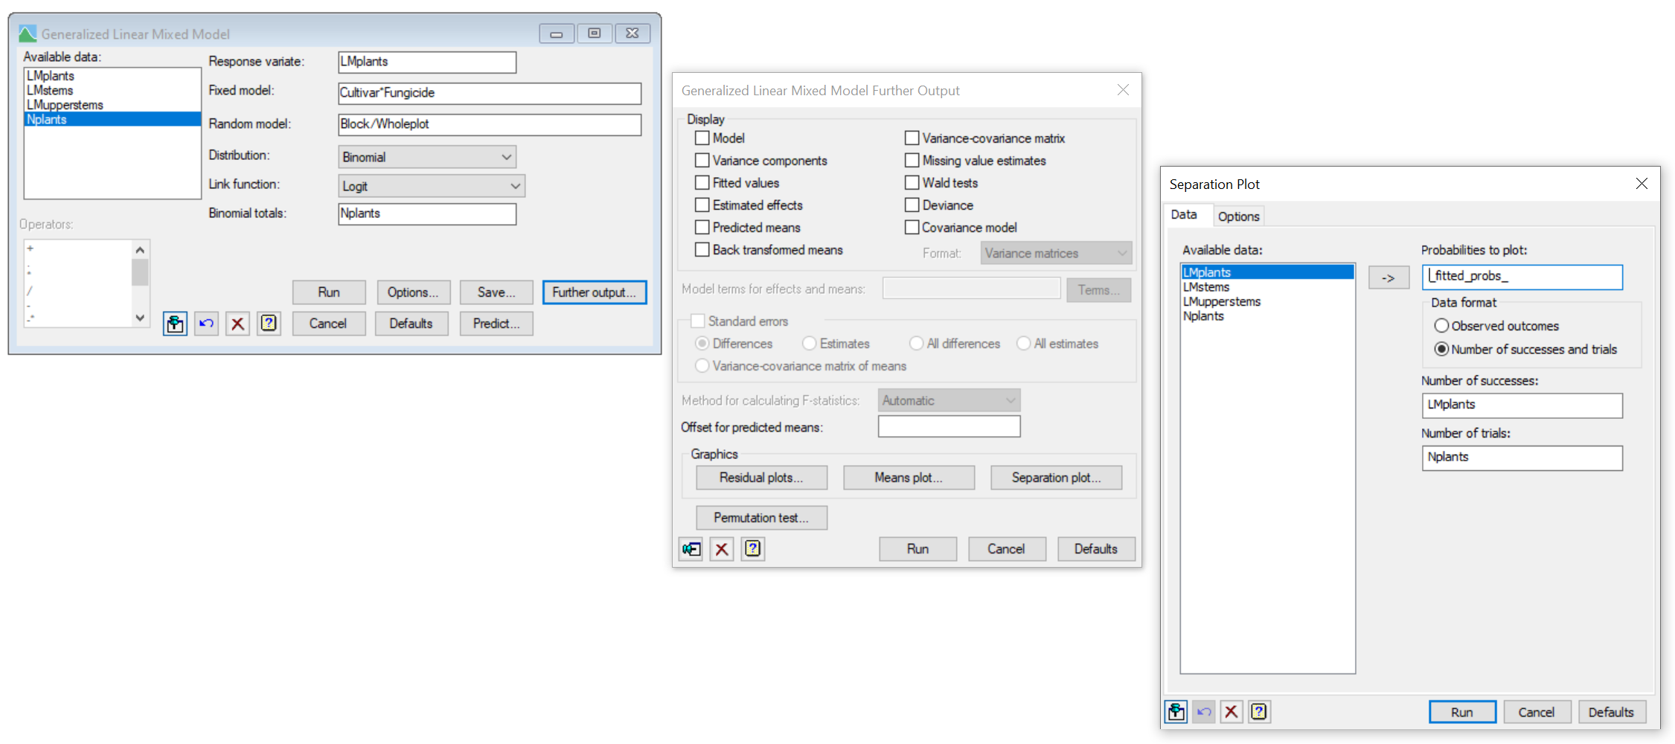

Separation plots
Separation plots allow you to visual the fit of a binomial GLMM
It shows the model’s ability to predict successes with high probability, and failures with low probability
Implemented in the procedure DSEPARATIONPLOT
Accessible from the GLMM Further Output menu
Also available for GLMs and HGLMs, and from the Graphics menu
Data tab automatically populates with the appropriate variables
Notes:
This brings me to the second new GLMM feature I wish to demonstrate – separation plots
A separation plot helps you to visual the fit of a binomial GLMM.
It shows the model’s ability to predict successes with high probability, and failures with low probability.
The procedure itself, DSEPARATIONPLOT, was introduced in Genstat 21, and in Genstat 22 separation plots were made available via various menus.
After fitting a binomial GLMM, if you open the Separation plot menu via the GLMM menus, a nice feature is that the data tab automatically populates with the appropriate variables based on your model. So the only thing you have to think about is setting the options.

Slide 14
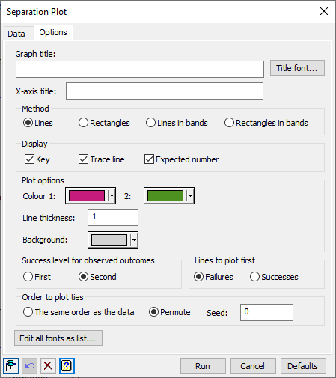
Separation plots
The Options tab controls the appearance of the plot
Separation plots come in two flavours
The predicted probabilities for each observed outcome (i.e. success or failure) can be plotted in…
a single graph
separate graphs
Reference: Greenhill, B., Ward, M.B. & Sacks, A. (2011). The separation plot: a visual method for evaluating the fit of binary models. American Journal of Political Science 55, 990-1002.
Notes:
From the Options tab you can control the appearance of the separation plot.
Separation plots come in two main flavours:
The predicted probabilities for both the observed success and failures can be plotted in a single graph or in separate graphs.

Slide 15
Separation plots
Can also plot the predicted probabilities as…
line segments
rectangles
Notes:
And for each of these flavours, we can plot the predicted probabilities as line segments or rectangles. In the next few slides I’ll demonstrate these four options

Slide 16
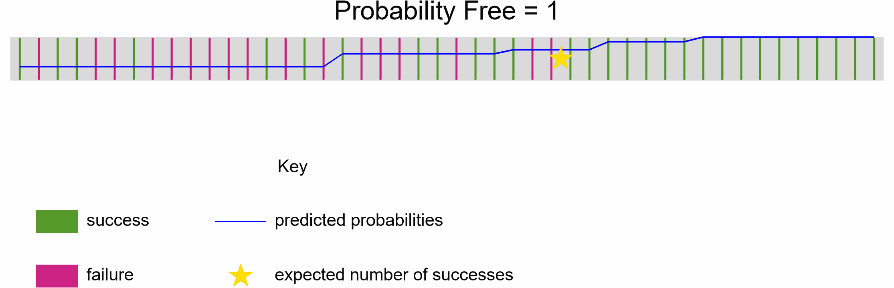
Method = lines
Predicted probabilities are ordered from smallest to largest
Plotted as line segments
The line segments are coloured according to whether or not the observation corresponds to a success
Example
Predicted probability of being Free from a disease following treatment
Notes:
With Method = Lines, the predicted probabilities are ordered from smallest to largest, and then plotted as line segments coloured according to whether or not the observation corresponds to a success
Here’s an example of such a graph. . In this example, the binomial GLMM is doing reasonably well, with failures, in pink, tending to be on the left side, i.e., the lower probability side, and successes, in green, tending to be on the right.

Slide 17
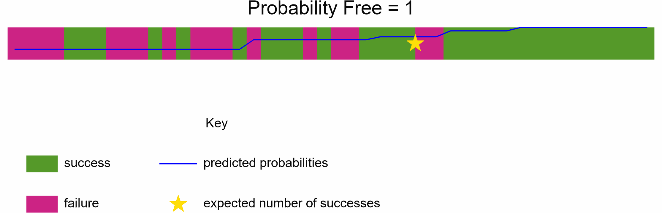
Method = rectangles
Predicted probabilities are ordered from smallest to largest
Plotted as rectangles
The rectangles are coloured according to whether or not the observation corresponds to a success
Example
Predicted probability of being Free from a disease following treatment
Notes:
The rectangles method is similar to the lines method except that rectangles are plotted instead of line segments
Here’s the same example, but now plotted as rectangles

Slide 18
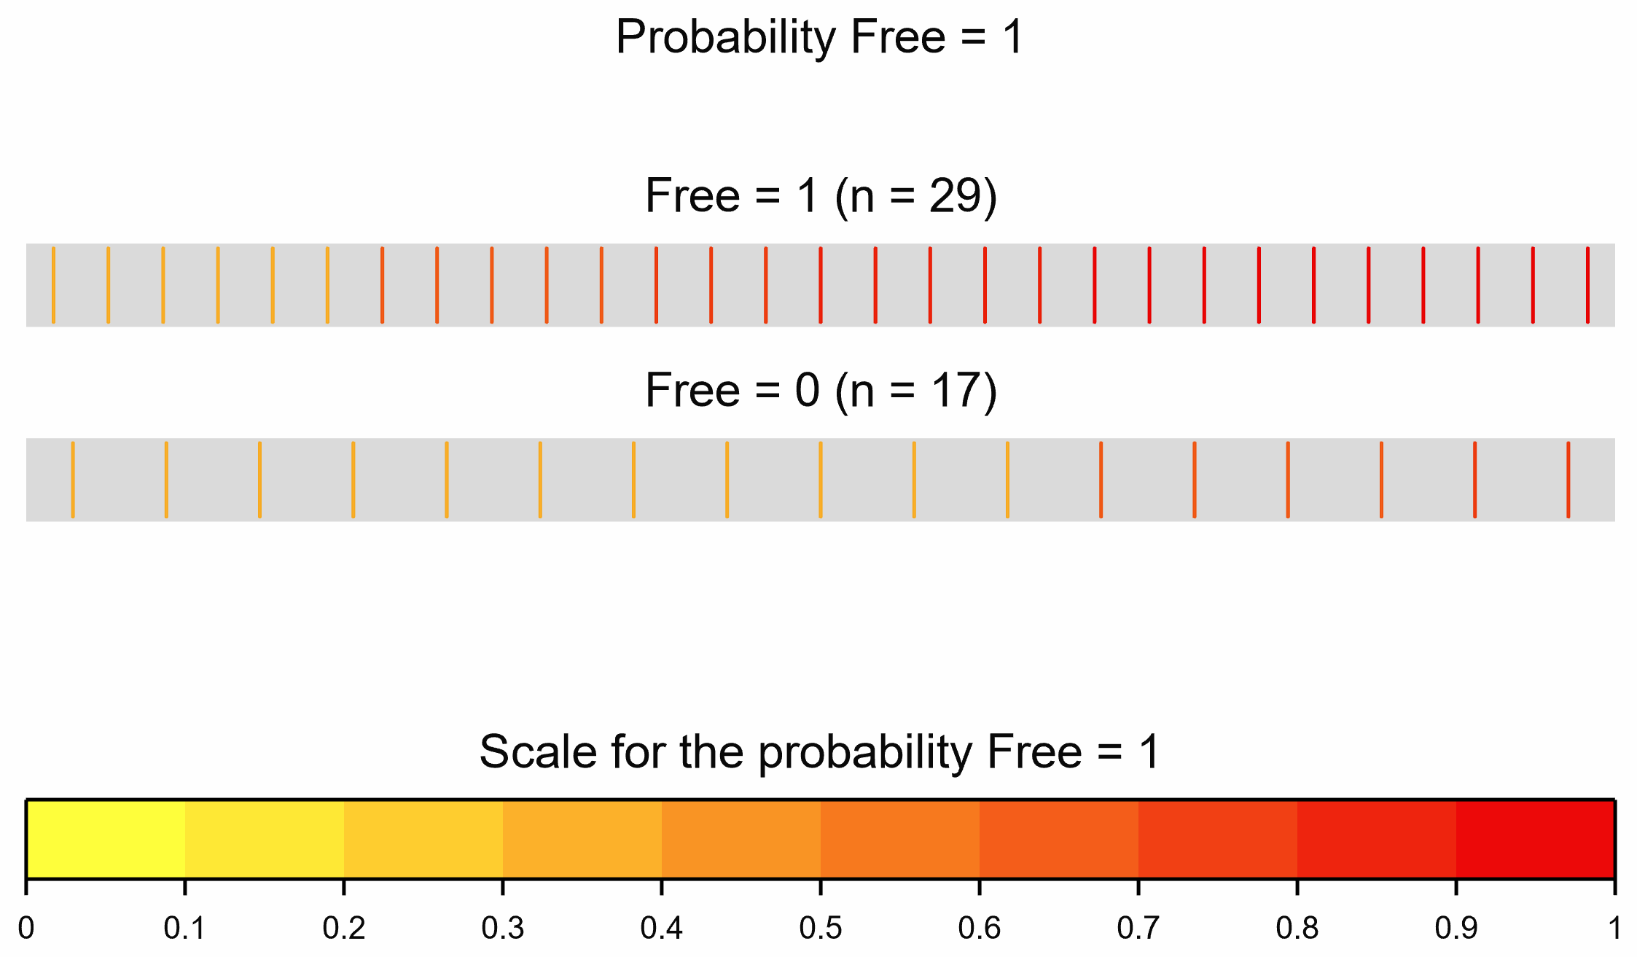
Method = lines in bands
Separately for the observed successes and failures:
The predicted probabilities are ordered from smallest to largest
Plotted as line segments
The line segments are coloured using a graduated band of colours formed by grouping the predicted probabilities into distinct band
Example
Predicted probability of being Free from a disease following treatment
Notes:
For the method of lines in bands a separate graph is drawn for each actual outcome : success or failure. For each outcome, the predicted probabilities are ordered from smallest to largest, and plotted as line segments. And the line segments are coloured using a graduated band of colours.
And here’s the same example, but now plotted as lines in bands

Slide 19
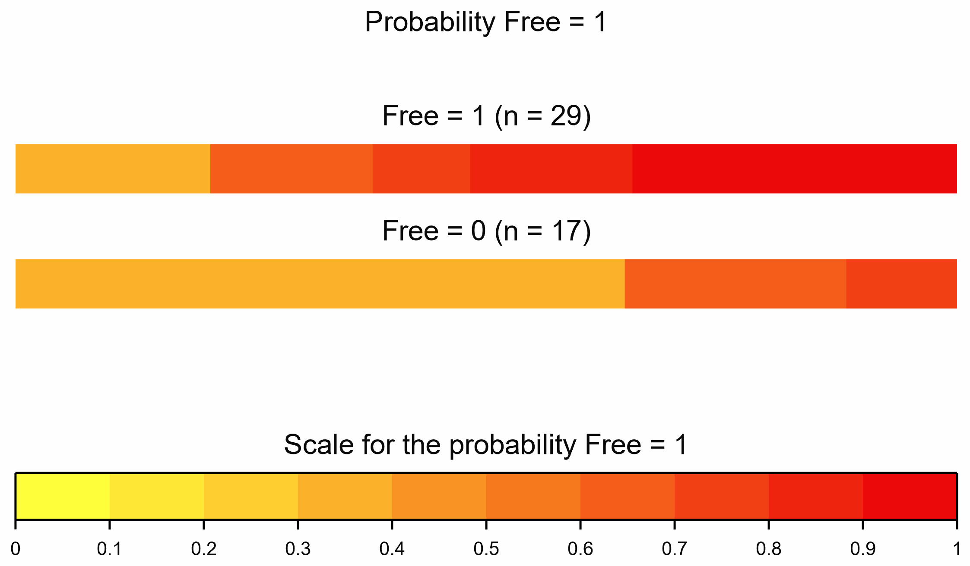
Method = rectangles in bands
Separately for the observed successes and failures:
The predicted probabilities are ordered from smallest to largest
Plotted as rectangles
The rectangles are coloured using a graduated band of colours formed by grouping the predicted probabilities into distinct band
Example
Predicted probability of being Free from a disease following treatment
Notes:
And finally, the rectangles in bands method is similar to the lines in band method except that rectangles are plotted instead of line segments
Here’s the same example, but now plotted as rectangles in bands
This is my preferred separation plot view.

Slide 20
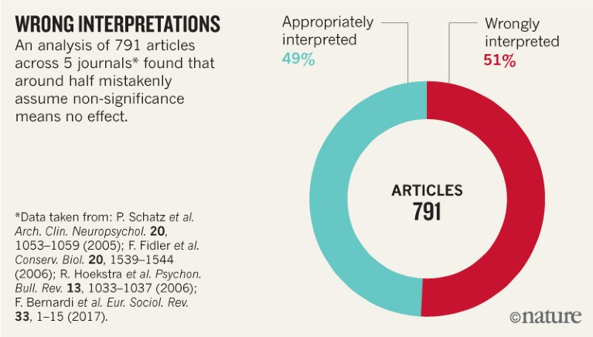
Equivalence, non-inferiority and non-superiority tests
A commonly made mistake is to accept H₀
This leads to poor decision making and potentially very dangerous consequences
Equivalence, non-inferiority and non-superiority tests “reverse” the onus of proof
Source: V. Amrhein et al.
Notes:
Right – this brings me to my next topic.
One of the other many new additions in Genstat22 are equivalence, non-inferiority and non-superiority tests.
A common mistake when interpreting p-values is to accept the null hypothesis when the p-value isn’t deemed small enough.
Accepting the null can lead to poor decision making and potentially very dangerous consequences…
Think of deciding that the unwanted side-effects of the new drug are, on average, the same as the standard drug based on a p-value viewed insignificant.
Failing to demonstrate an effect is not the same as proving no effect
And this is where the Equivalence, non-inferiority and non-superiority tests come into play as they let us reverse the onus of proof

Slide 21


Equivalence tests
Useful when the aim is to demonstrate that two treatment means are effectively the same
?
New
Drug
The same
Standard
Drug
H₀: the means are different
H_{a}: the means are effectively the same
Notes:
Equivalence tests are extremely useful when the aim of the study is to demonstrate that two treatments are effectively the same.
For example, in a medical trial when the aim is to prove that a new drug treatment gives on average the same treatment response as the standard drug.
Under a equivalence test, the null hypothesis is that the means are different, and the alternative is that they are effectively the same.
The word “effectively” is key here. We can never prove that the means are exactly the same, so instead we have to define a range of values under which the means are deemed for all intents and purposes to be the same.

Slide 22
Equivalence tests
Implemented in procedure TEQUIVALENCE
Uses the two one-sided t-tests (TOST) method
Specify the range of differences (∆) over which the means can be regarded as equivalent: [L,U]
Calculate the difference between the means: ∆
Perform a one-sided t-test with H₀: ∆ < L
Perform a one-sided t-test with H₀: ∆ > U
Take as the overall p-value the larger of the two p-values
H_{a}: L ≤ ∆ ≤ U
Notes:
Equivalence tests have been implemented in the TEQUIVALENCE procedure, which uses the TOST method. This stands for two one-sided t-tests.
In brief, we specify the equivalence limits, which is the range of differences over which the two means can be regarded as equivalent. Importantly – this should be specified prior to the experiment being conducted
After the data has been collected, we then calculate the difference between the means.
Using the pre-specified equivalence limits, we then perform 2 one-sided t-tests. One with the null hypothesis that the observed difference is less than the lower limit of equivalence, and one with the null that the difference is greater than the upper limit.
The overall p-value is taken as the larger of these two p-values
If both tests are significant, we can conclude that the treatments are equivalent.

Slide 23
Non-inferiority tests
Useful when the aim is to demonstrate that one treatment mean is not unacceptably lower than another treatment mean
H₀: ∆ < L
H_{a}: ∆ ≥ L
Non-superiority tests
Useful when the aim is to demonstrate that one treatment mean is not unacceptably higher than another treatment mean
H₀: ∆ > U
H_{a}: ∆ ≤ U
Notes:
We also have non-inferiority tests and non-superiority tests, which are the one-sided versions of the equivalence test.
The non-inferiority test is used when the aim is to demonstrate that one mean is not unacceptably lower than another.
And the non-superiority when the aim is to demonstrate that one mean unacceptably higher than another

Slide 24
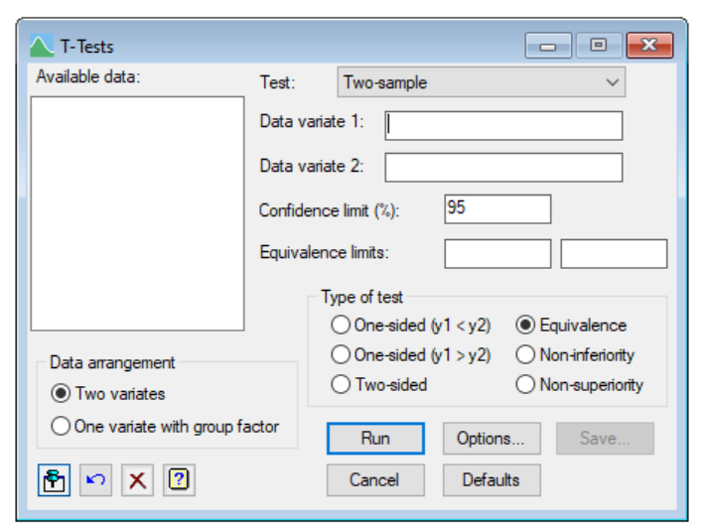
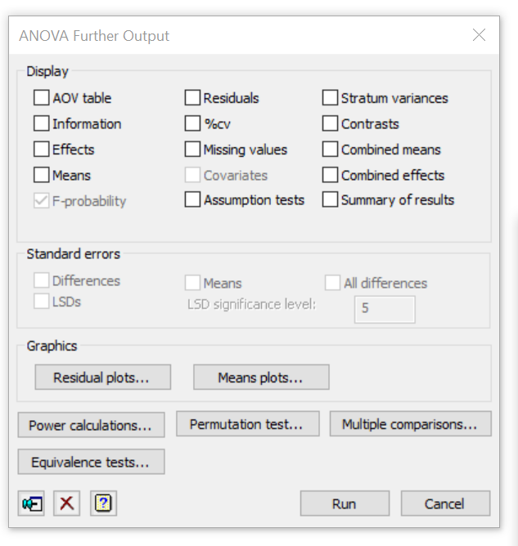
Equivalence, non-inferiority and non-superiority tests
Now available in the T-tests and ANOVA Further Output menus
New
New
Notes:
In Genstat 22 we’ve made it really easy to conduct these test by adding them to the T-test and ANOVA Further Output menus. If your working in another analysis framework, such as LMM, you can of course use the procedure directly.

Slide 25
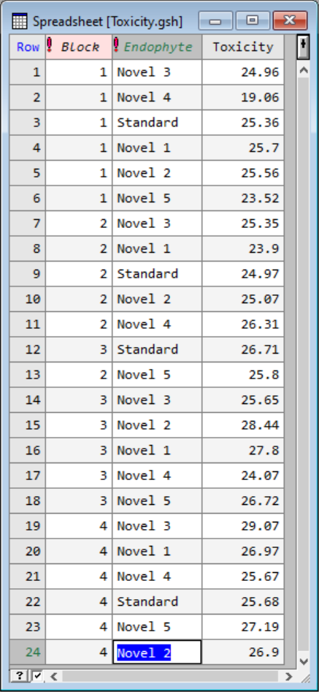
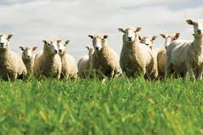
Example
Endophytes are fungi which live within grasses
They produce loline which protects pasture from insect pests
However, some endophytes are toxic to livestock
A randomised complete block experiment was conducted to assess the toxicity response of 5 novel endophytes against the industry standard
The aim was to identify novel endophytes with the same mean toxicity measure as the industry standard
Notes:
Let’s look at an example, involving endophytes. These are fungi that live with grasses and are very useful in livestock pastoral farming as they help protect pasture from insect pests.
Unfortunately, though some endophytes are toxic to livestock so before a new endophyte is used commercially, we must make sure it is safe.
In this experiment the aim was to identify novel endophytes with the same mean toxicity measures as the industry standard.

Slide 26

Example
Equivalence defined as the means being within +/- 2.5 units
Testing the means against level Standard of Endophyte
Notes:
After analysing the data using ANOVA, we can perform our required equivalence tests.
Here, equivalence was defined a-priori as the means being within +/- 2.5 units.
And we are testing the means against the level Standard of the treatment term, Endophyte

Slide 27
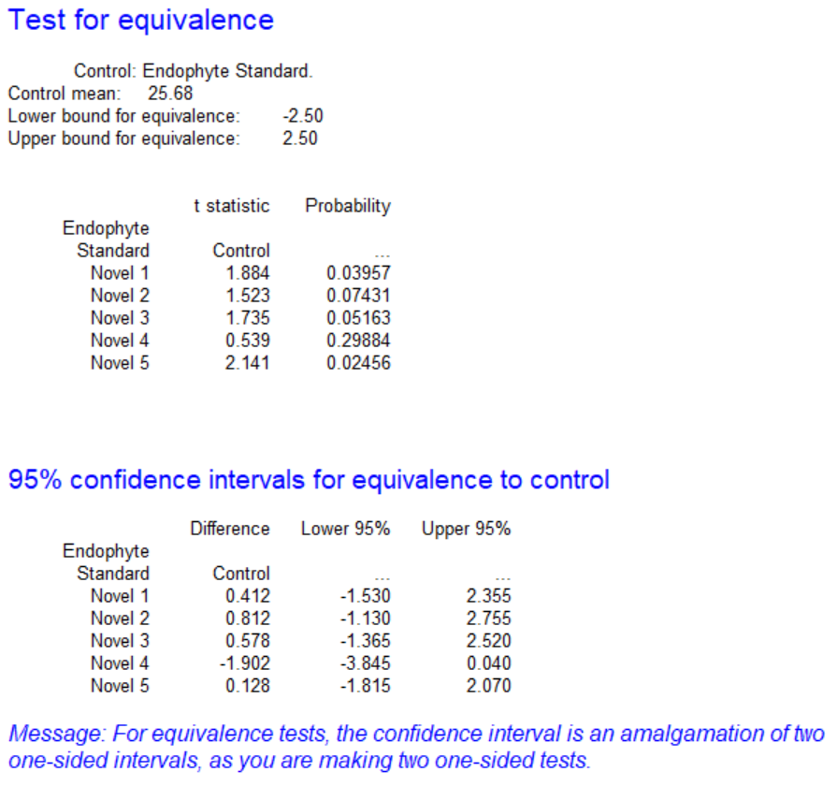
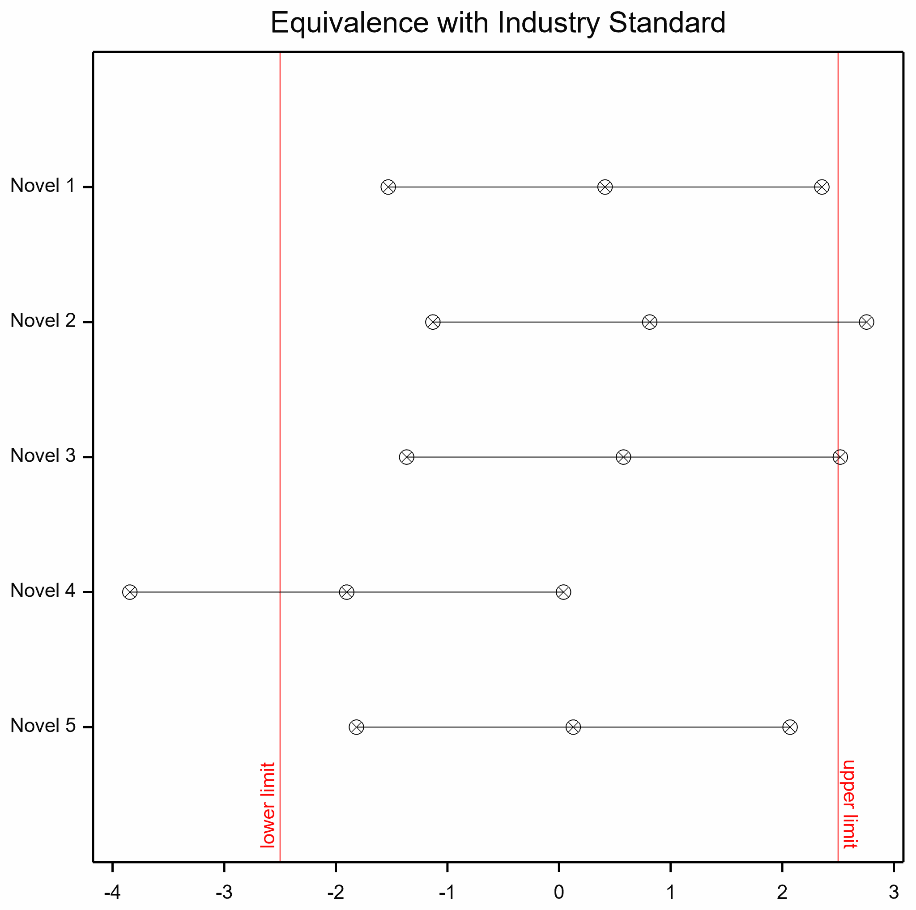
Example
Notes:
The p-values associated with two of the novel Endophytes are less than 0.05– number 1 and number 5: Therefore, at the magical 5% significance level, we can reject the null hypothesis for these two novel endophytes and conclude that they have mean toxicity measures equivalent to that of the industry standard.
This conclusion is also evident from looking at the graph – the confidence intervals for the first and the 5th novel endophytes lie completely within the equivalence limits.
Now I’m going to hand you over to David to talk about modelling censored data, a feature stemming from code Murray shared to the Genstat list.

Slide 28
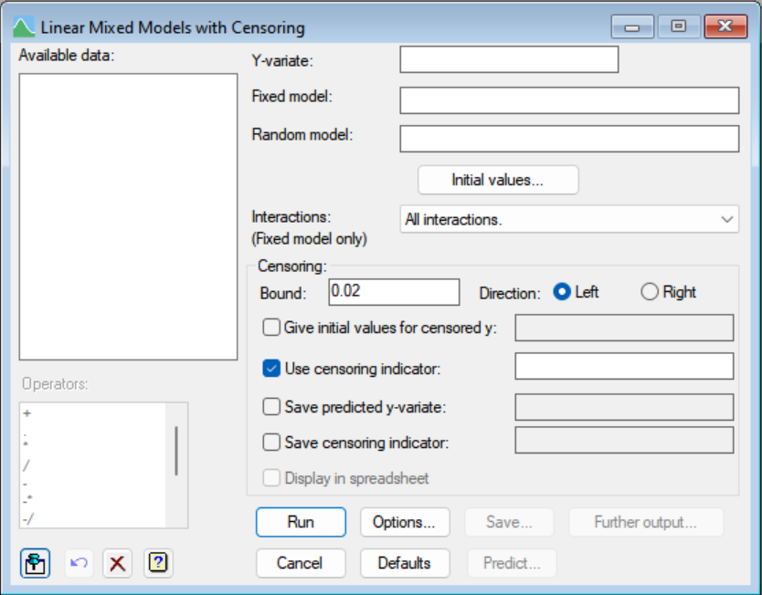
Censored data in REML models
Uses new TOBIT procedure
New Linear Mixed Models with Censoring menu

Slide 29
Tobit model (right censored)
Replaces censored value with expected tail value
E(x) = PRNORMAL(z)/CUNORMAL(z), z = (x-m)/s
However, m and s depend on E(x)
E-M algorithm
Start e_{i} = bound
Calculate m and s from REML
Calculate e_{i} from estimated m_{i} and s_{i}
Stop when changes in e_{i} are less than some tolerance

Slide 30
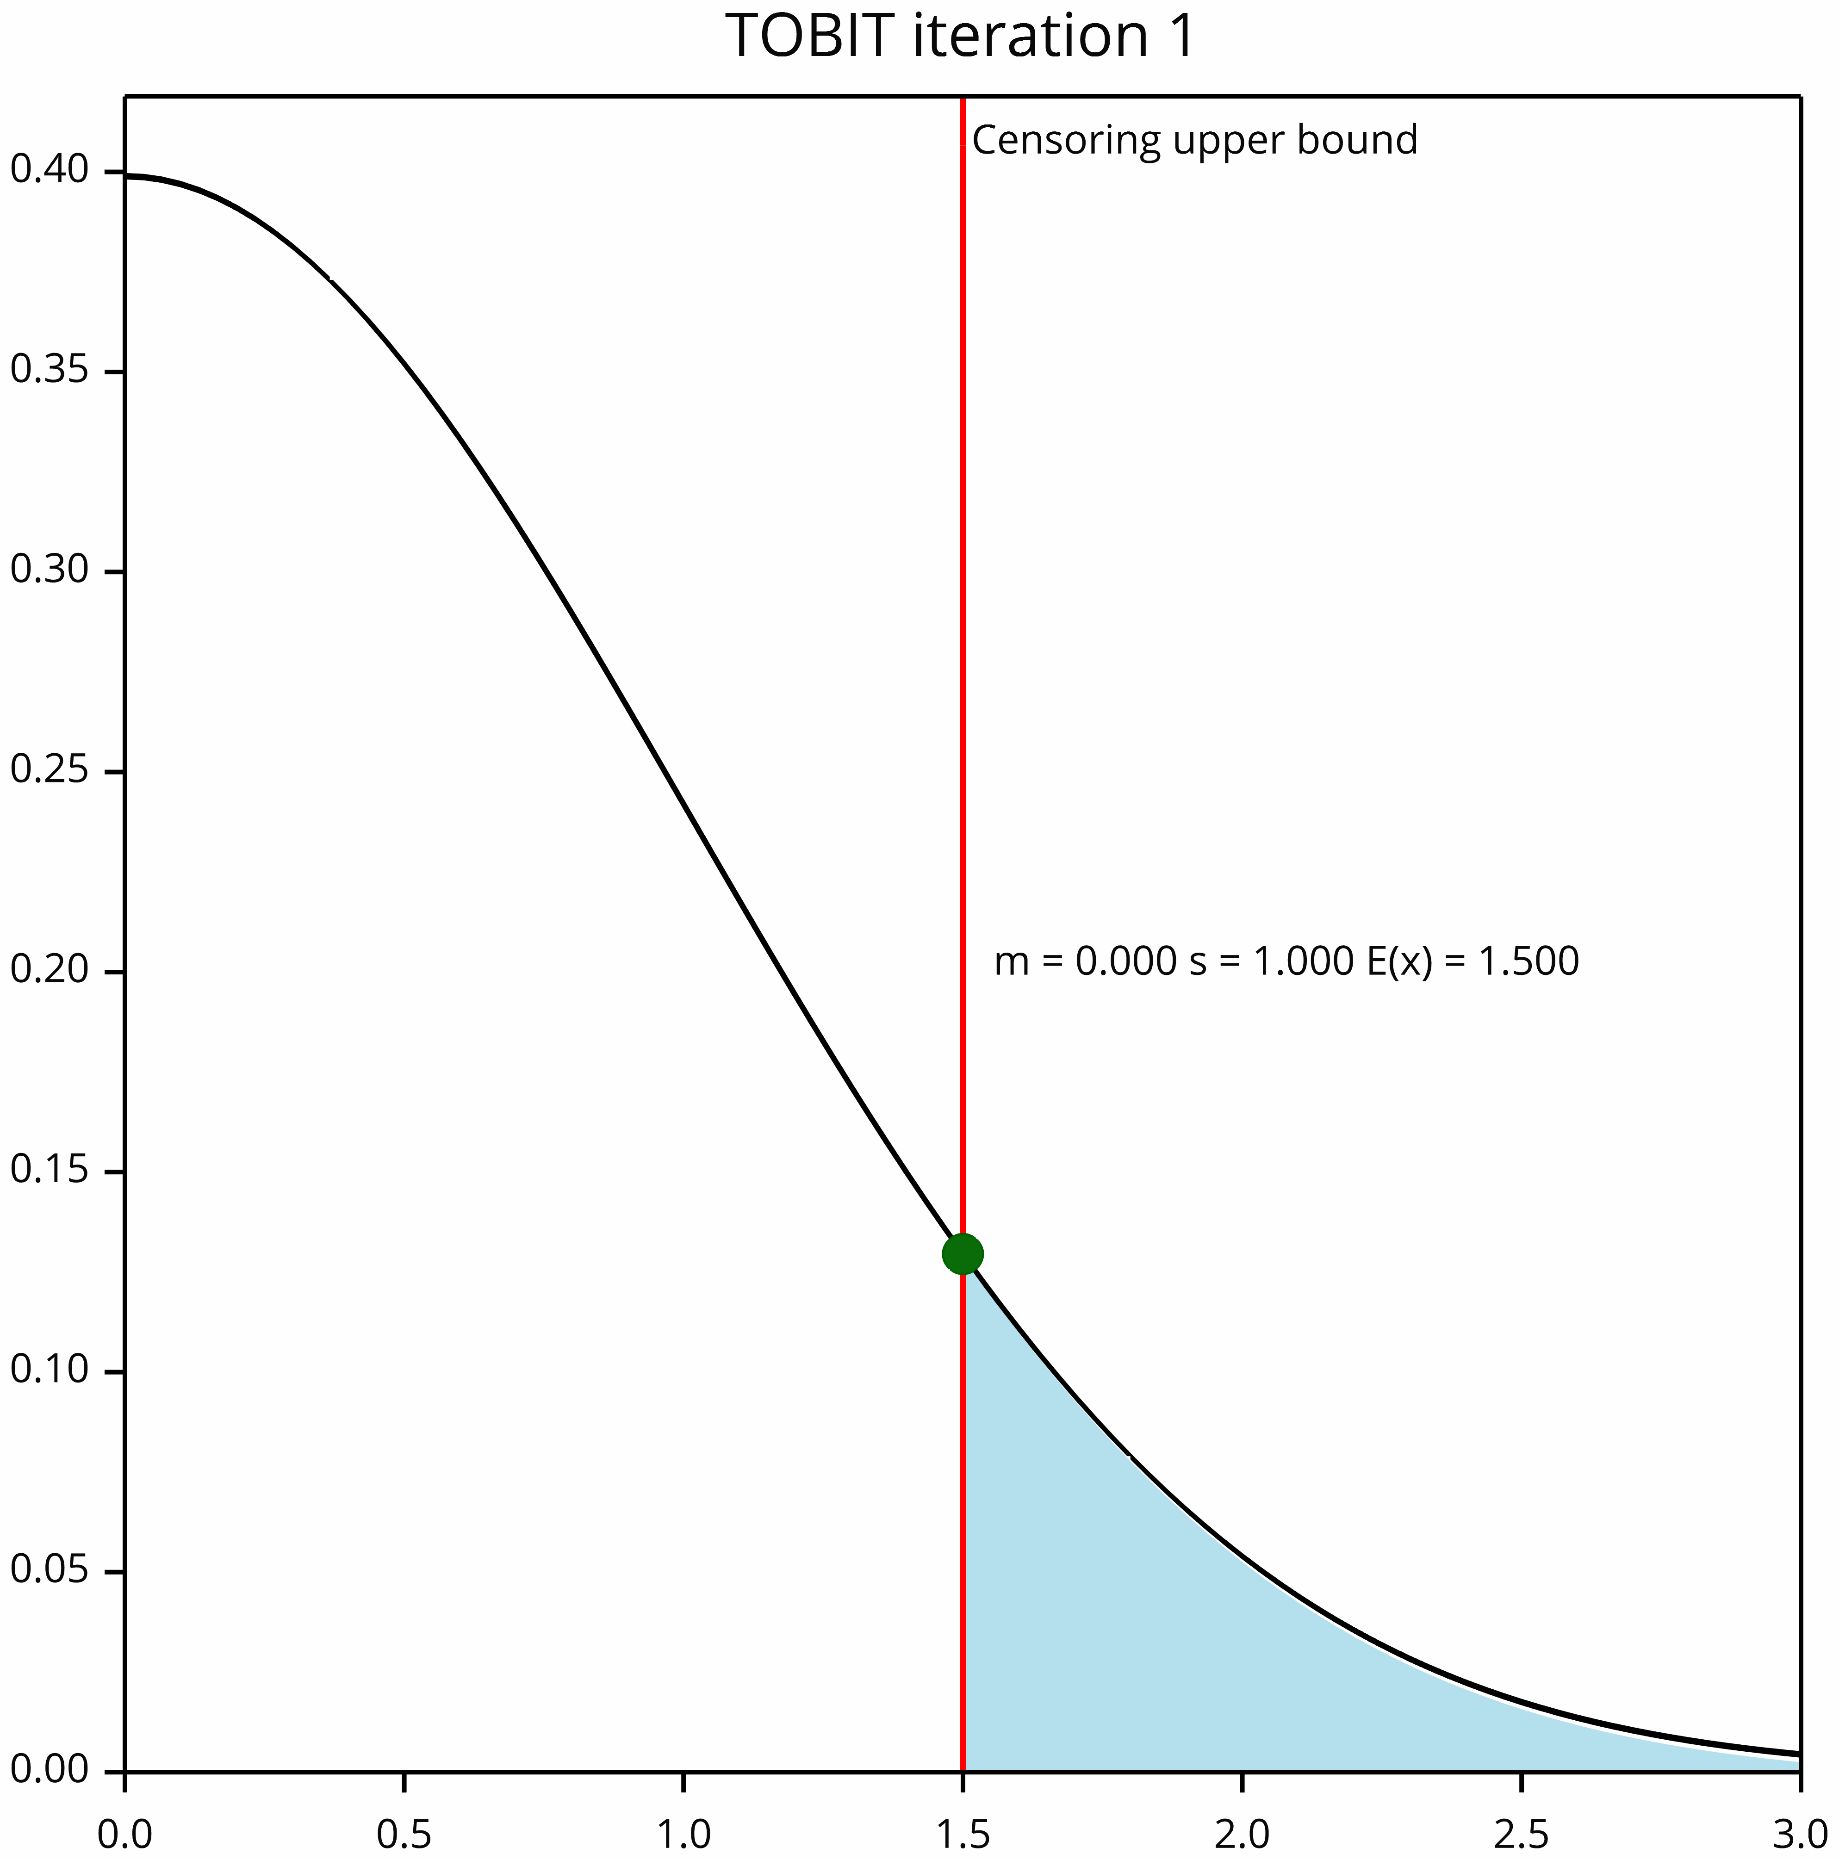
Starting iteration

Slide 31
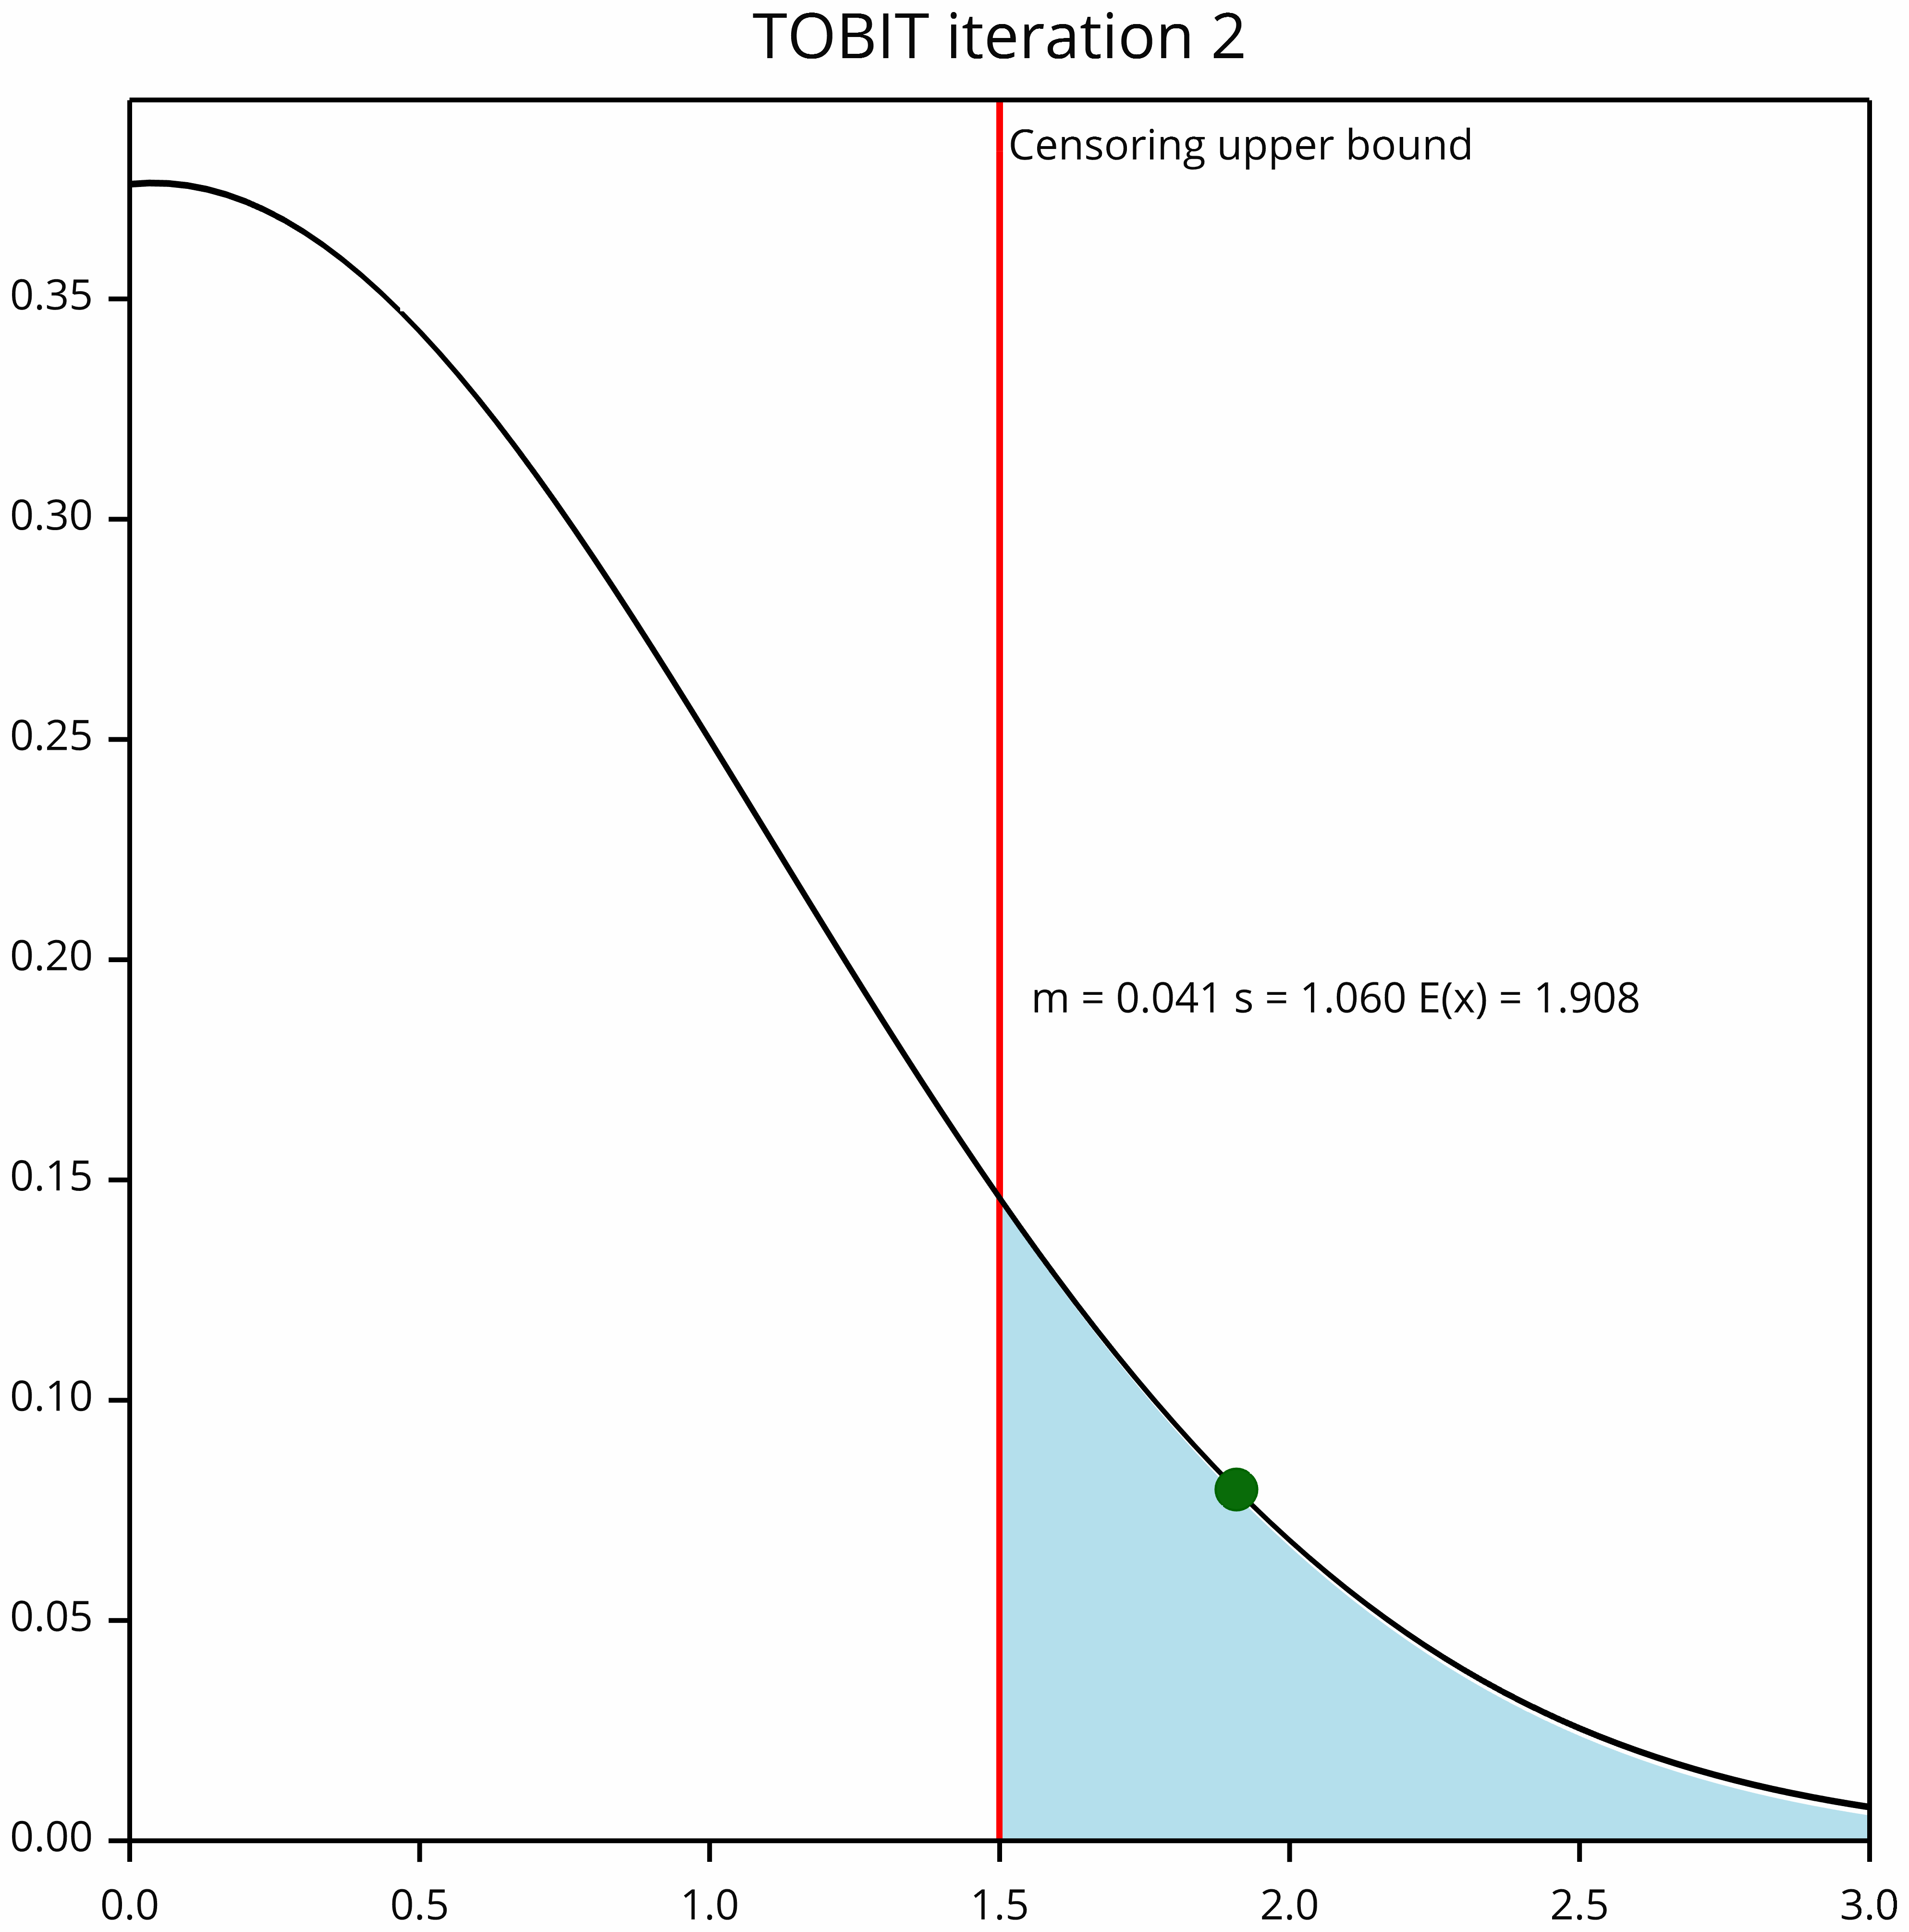
Iteration 2

Slide 32
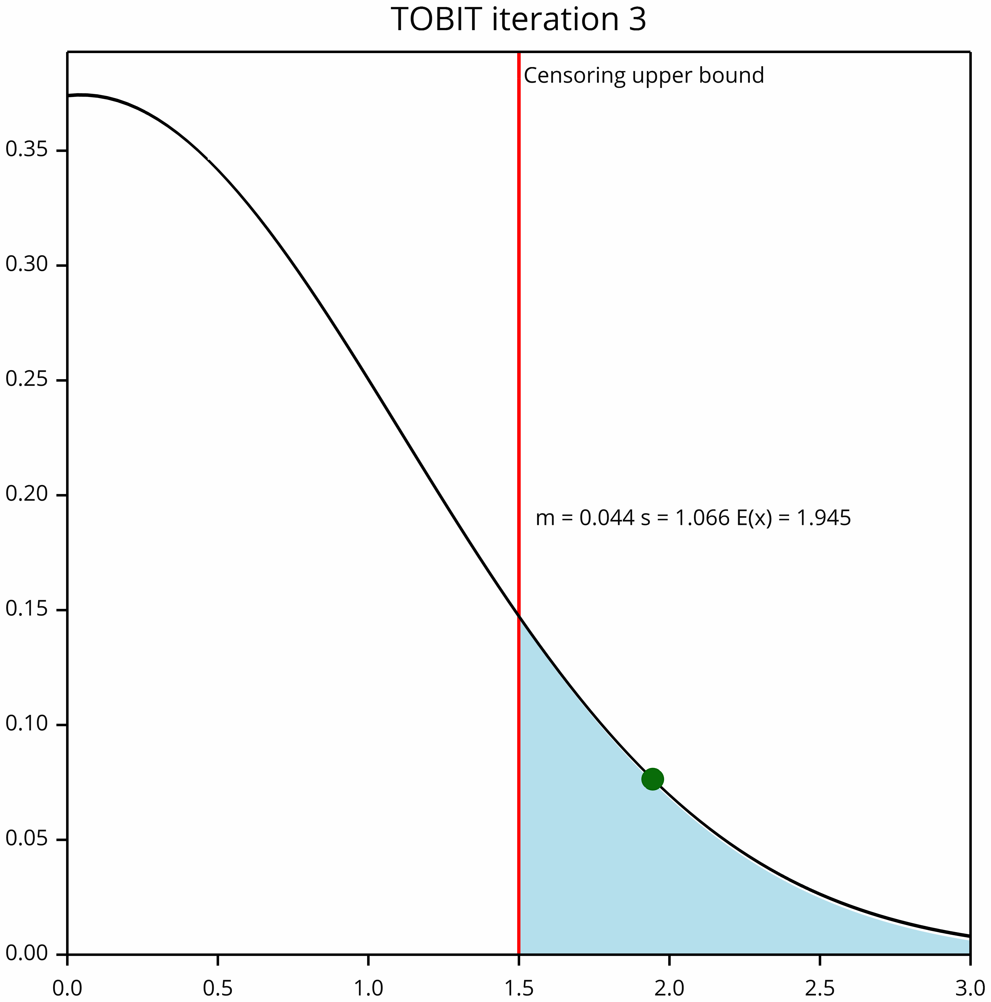
Iteration 3

Slide 33

Iteration 4

Slide 34

Convergence at iteration 5

Slide 35
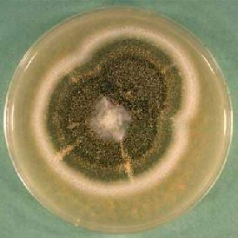
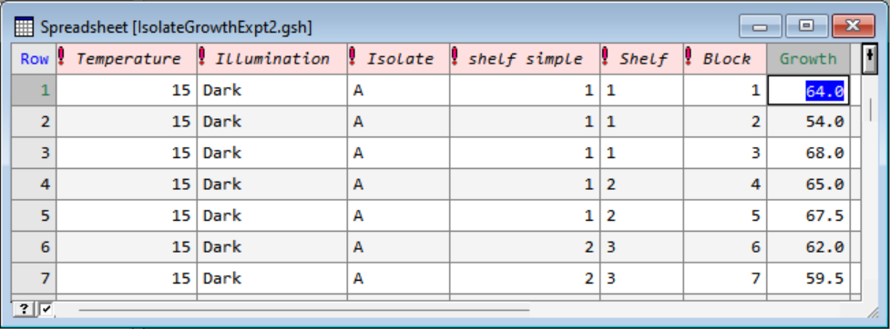
Censored data example
Isolates grown on agar plates
Measured area covered on plate
Area censored when growth covers full plate
4 isolates grown with and without light at 3 temperatures x 6 replicates
Thanks to Jonty Mills for data

Slide 36
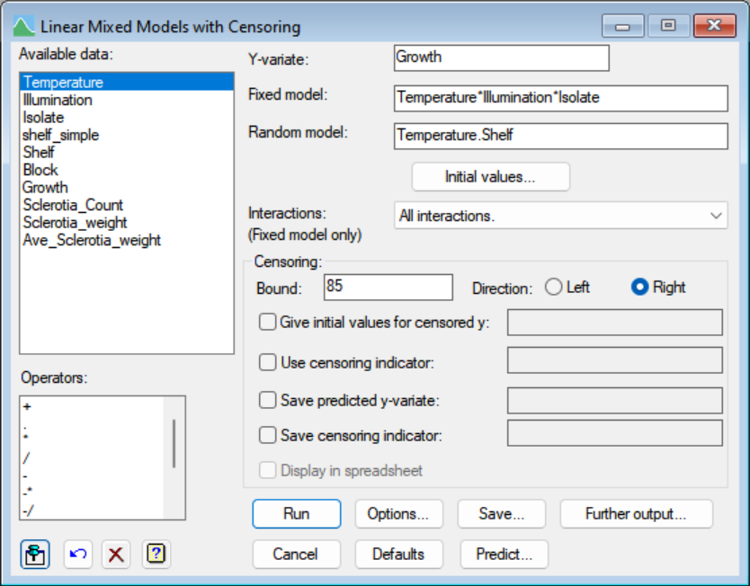
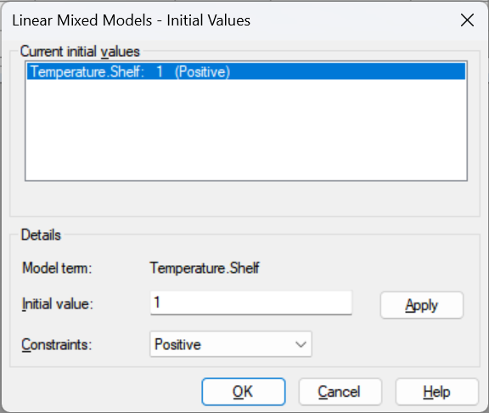
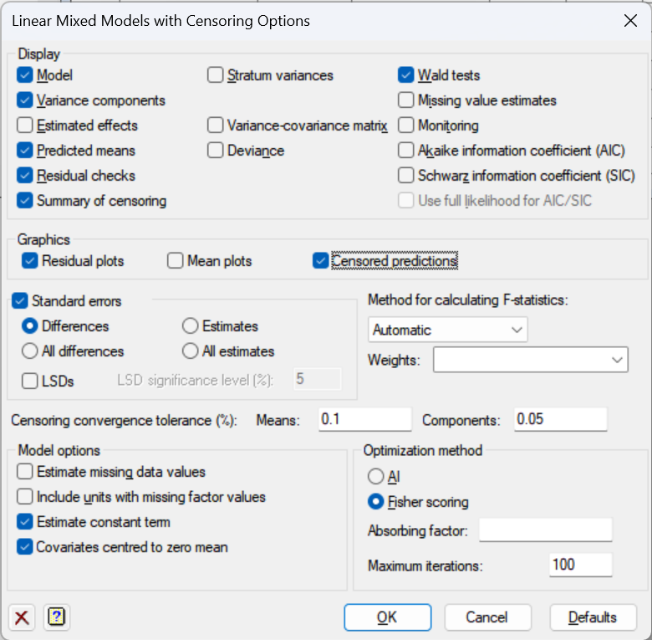
LMM with Censoring menu

Slide 37
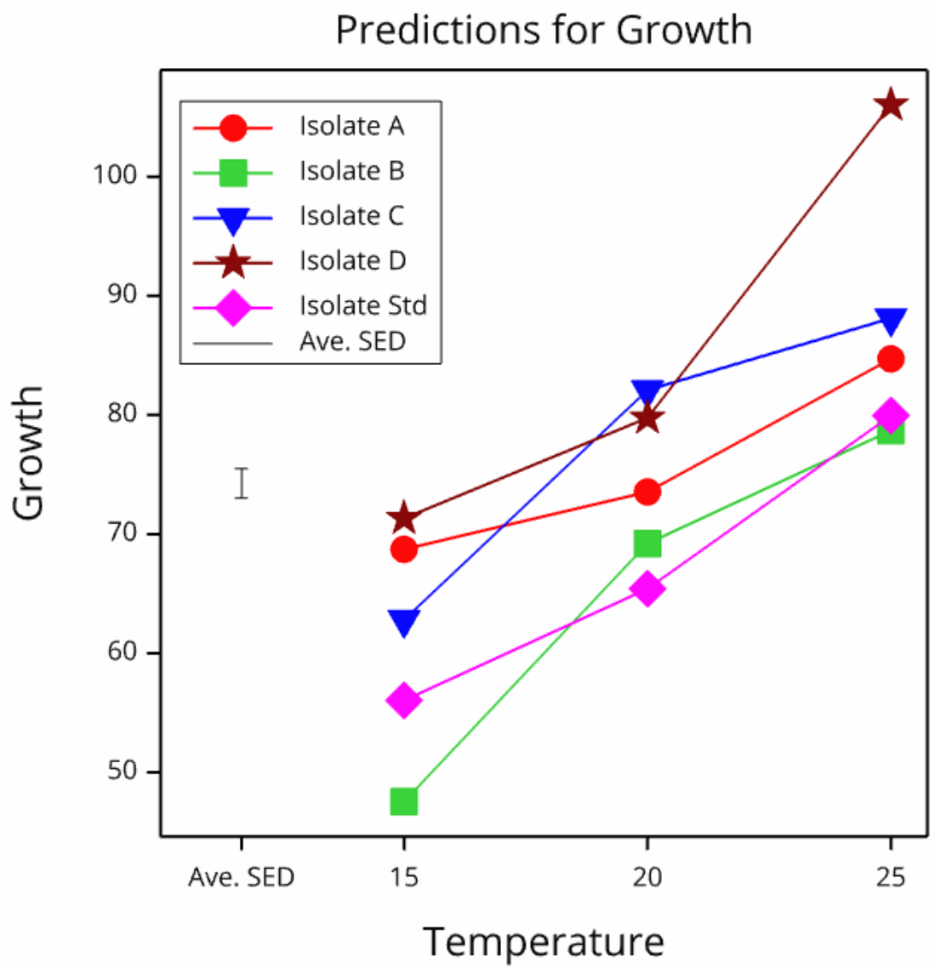
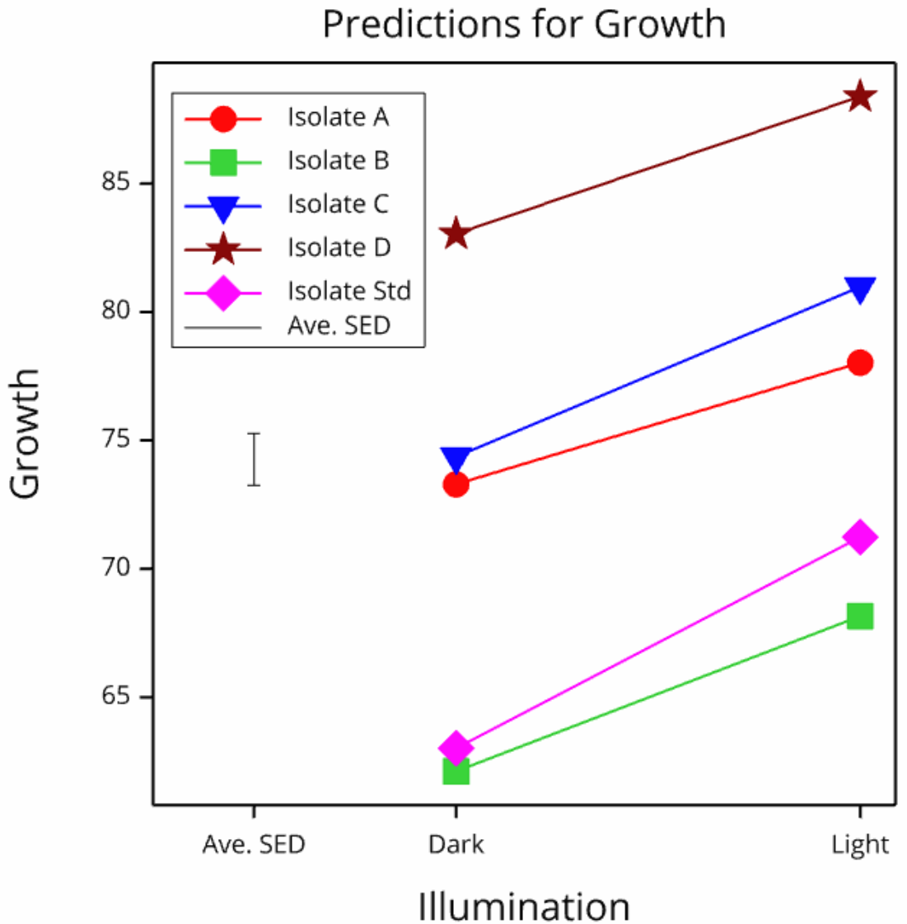
Effects on isolates
Isolate D the best, grown in light at 25 degrees

Slide 38
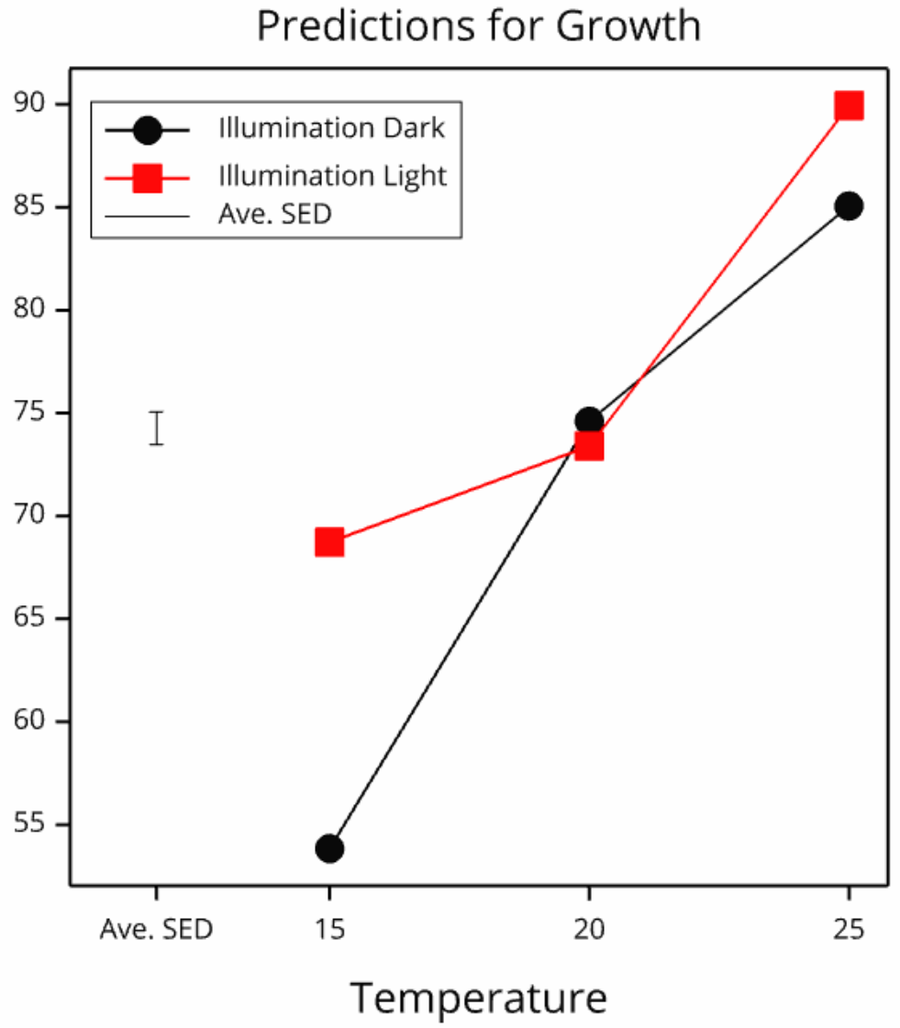
Temperature x illumination interaction
Need light at lower temperatures

Slide 39
Censored data in GLM/GLMM/HGLM
Added in 23rd edition for Poisson distribution
Expectation of x in upper tail from a Poisson distribution with mean m
E(x) = SUM(i x Pr(i))/SUM(Pr(i)), i=bound...∞
E(x) may be non-integer, but GLM calculations handle this

Slide 40

Censored Poisson example
An experiment was conducted to investigate whether a novel endophyte provided ryegrass protection against a common pasture insect pest, thus resulting in bigger plants with more tillers​
The treatment structure is a factorial with the three factors, each with two levels: Cultivar, Endophyte and Insect​
The experiment had a randomised complete block design with 7 replicates​
Tiller counts from quadrat samples
Stopped counting at 200 tillers

Slide 41
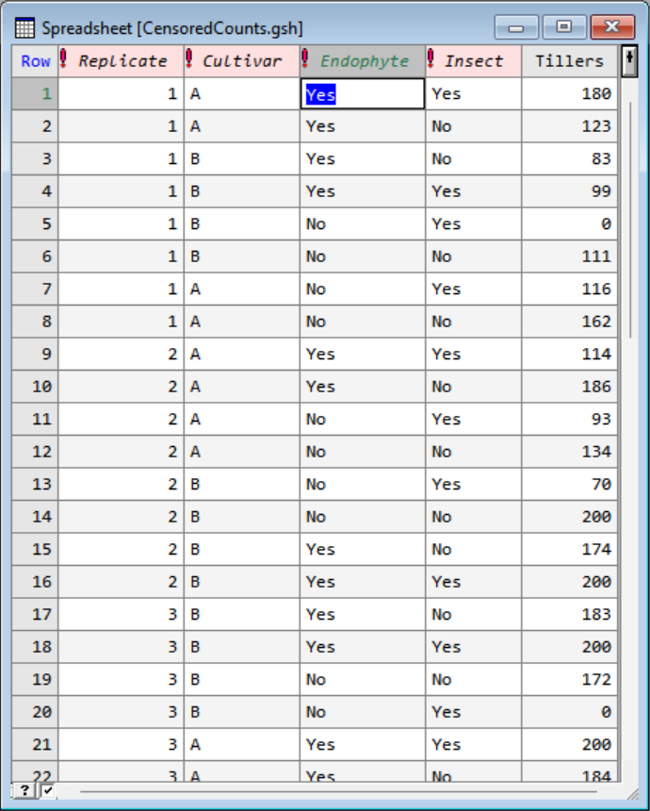
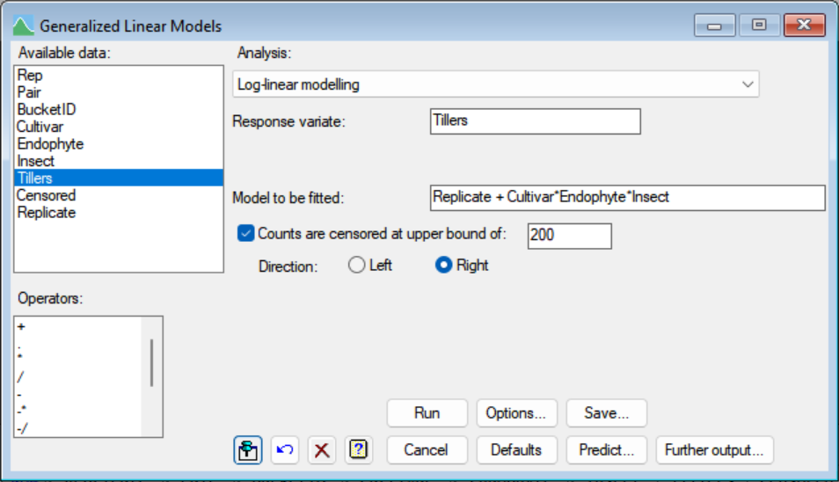
Censored Poisson menu

Slide 42
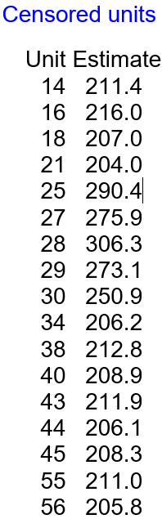
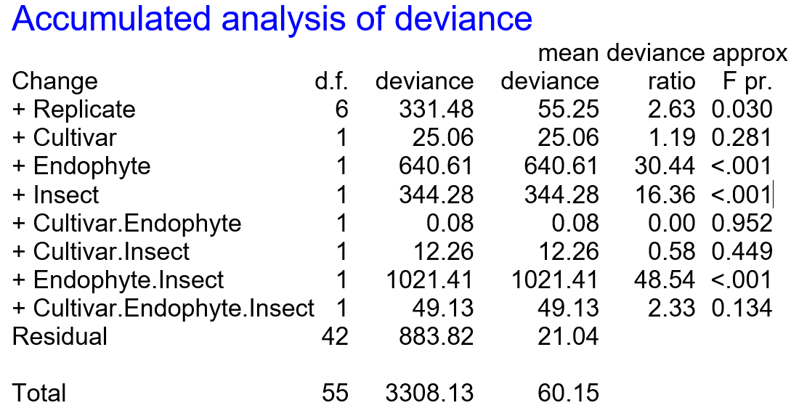
Tiller experiment results

Slide 43
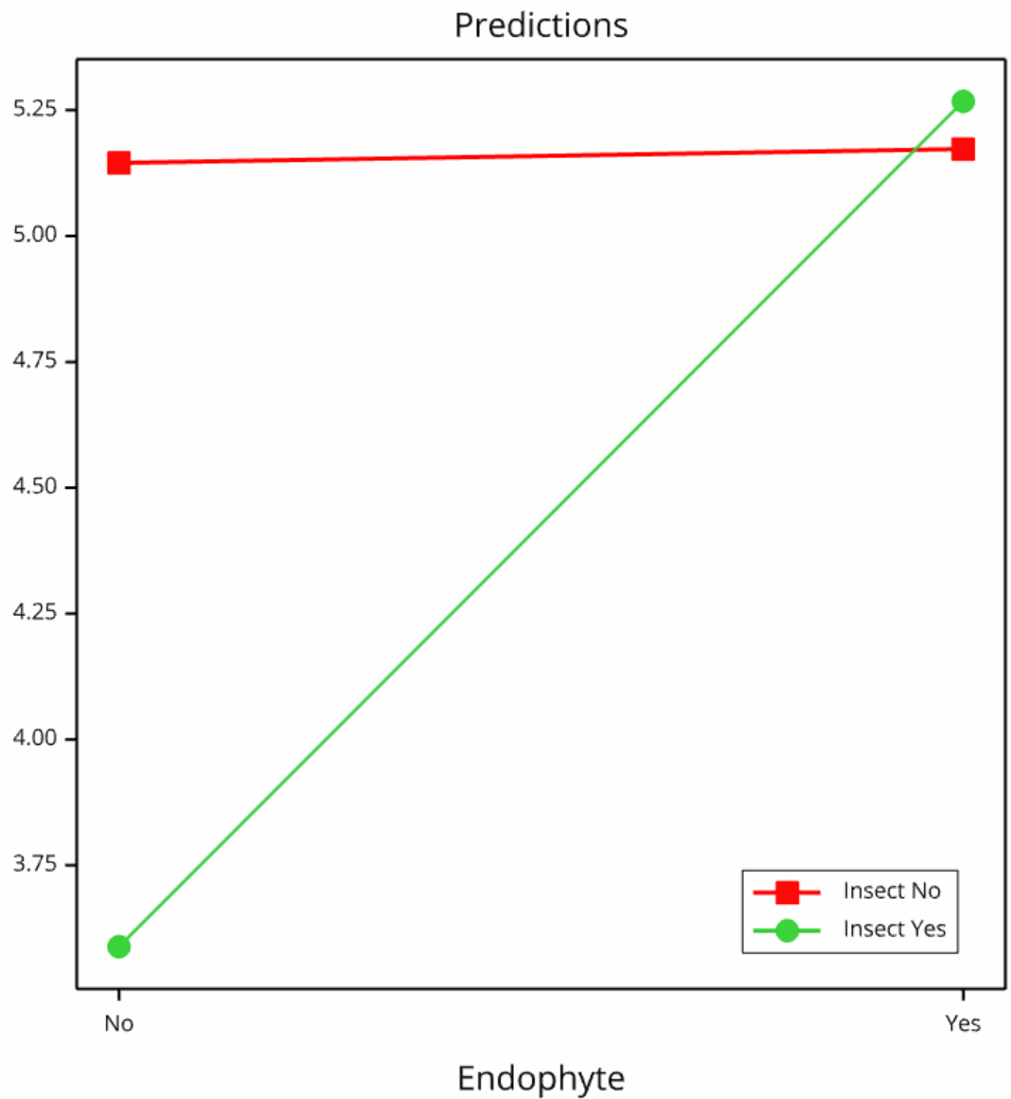
Tiller experiment results
Insects kill tillers when there is no endophyte

Slide 44
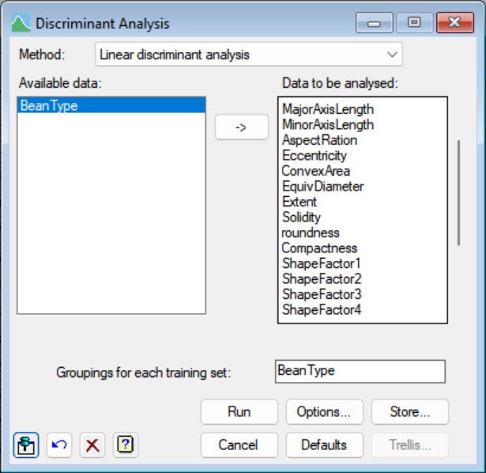
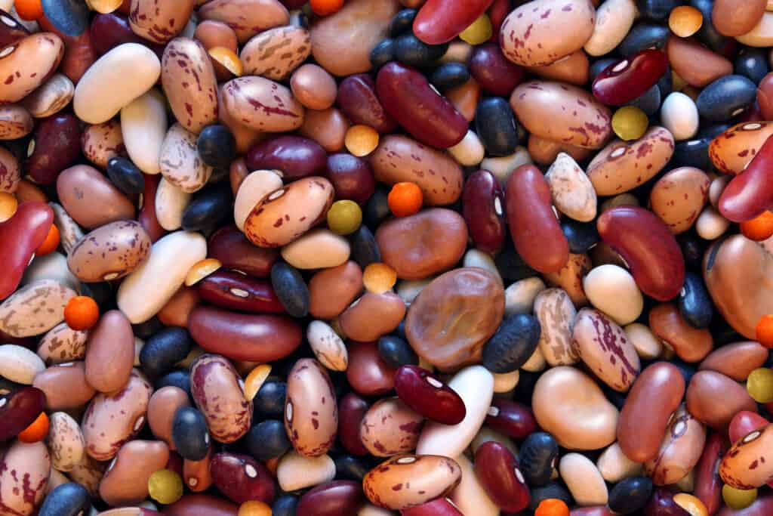
New 2d Groups Trellis plot
New graph type with bar or pie charts in 2d-Trellis
Added in as an option in the discrimination menus
Dry bean example – morphometric measurements of 7 bean species

Slide 45
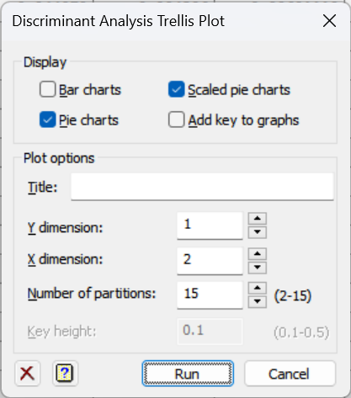
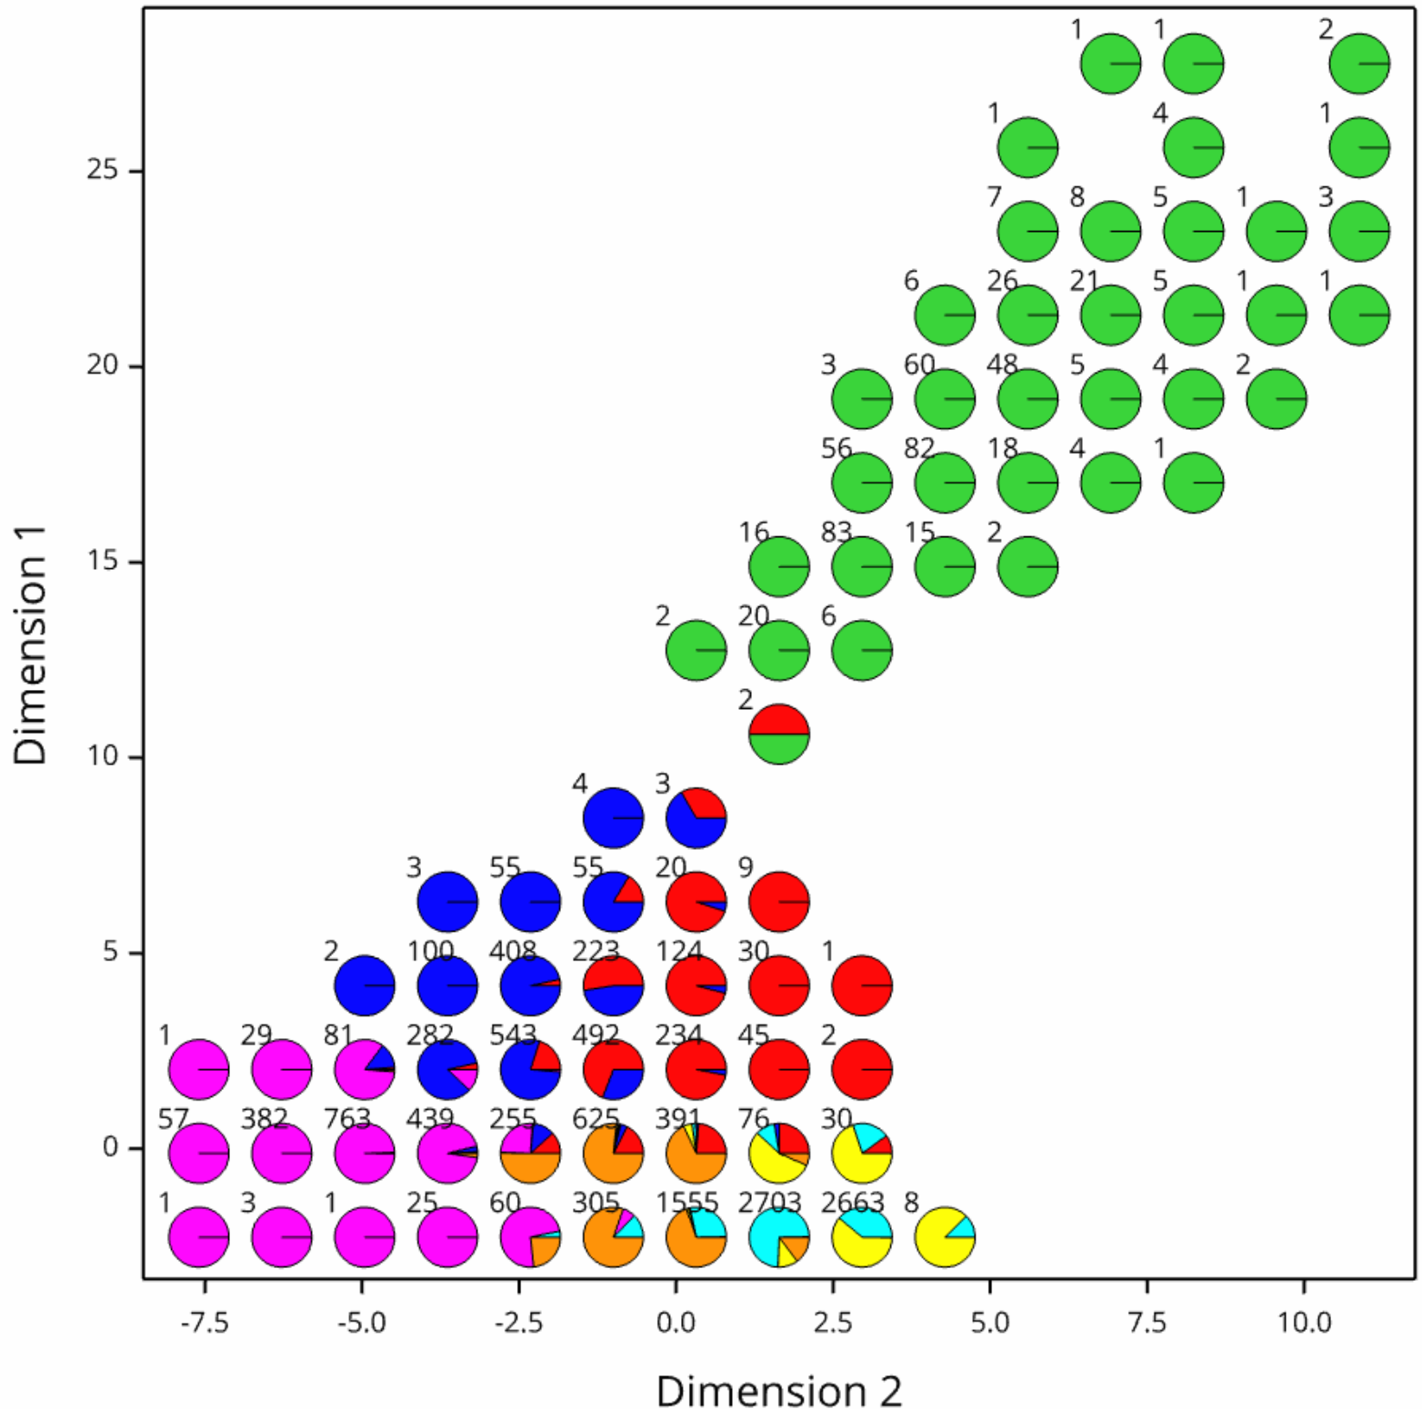
New 2d Groups Trellis plot

Slide 46
New command insertion menu
Build command knows the complete syntax of the Genstat language
Easy searching for that elusive Genstat command
Can control the output of the command
On right click menu or toolbar
Can insert code snippets
Can edit and define your own code snippets
Can share code snippets with others

Slide 47
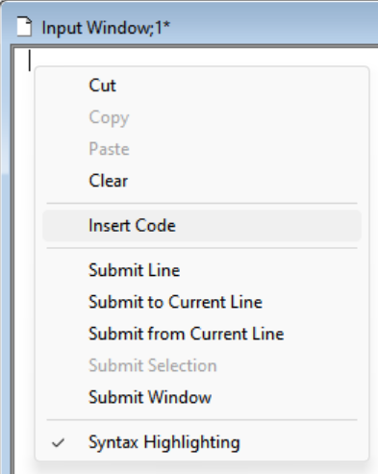
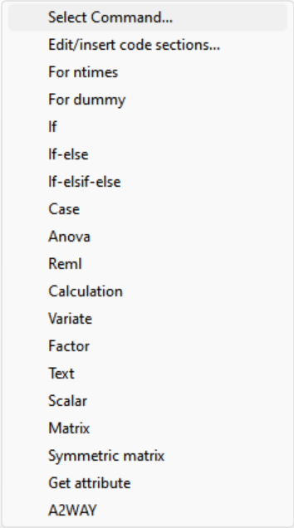
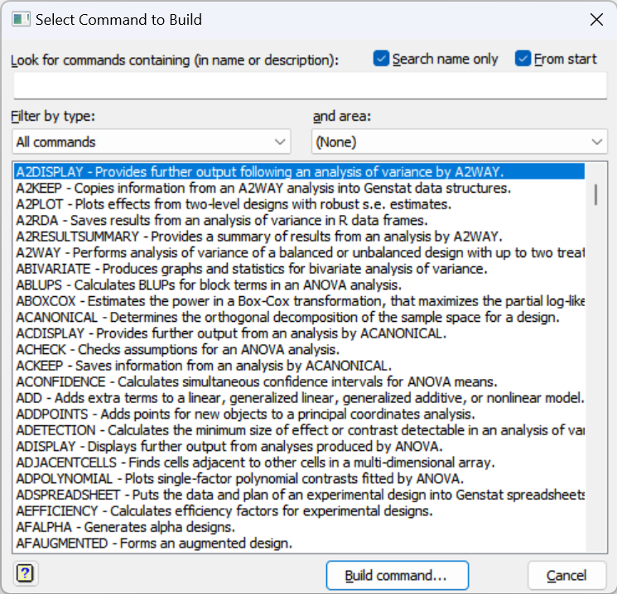
A2WAY example

Slide 48
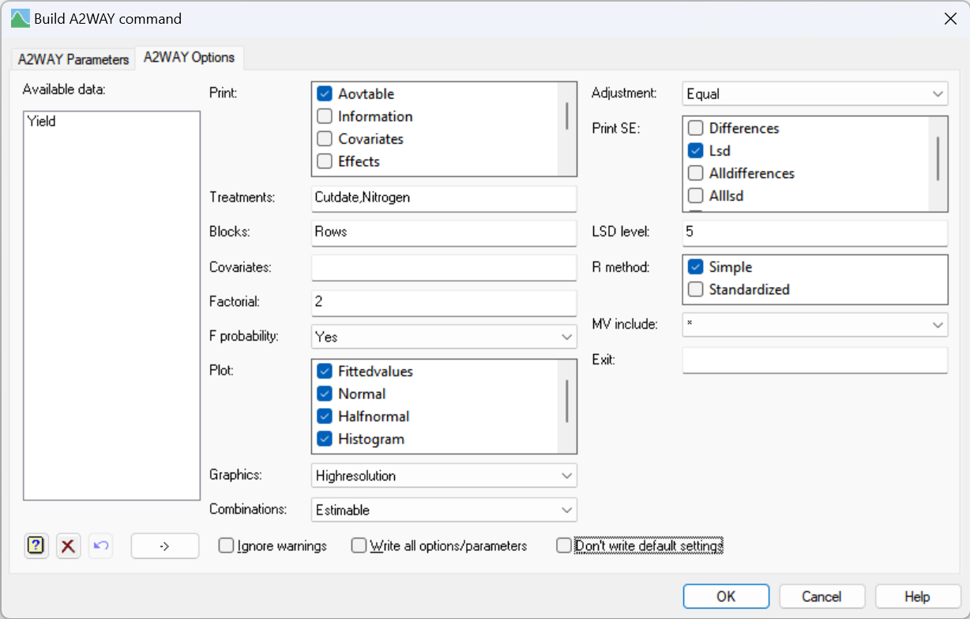
A2WAY Example

Slide 49
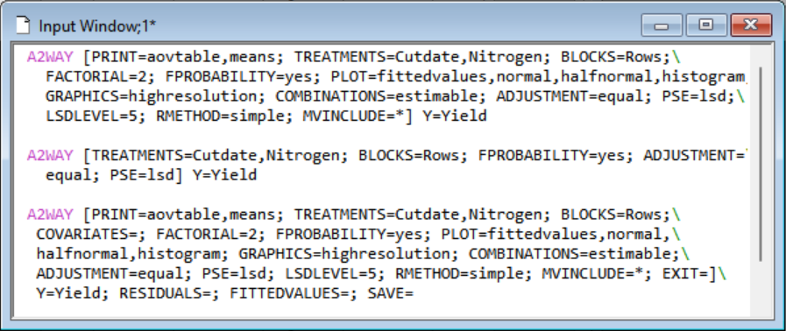
A2WAY Example

Slide 50
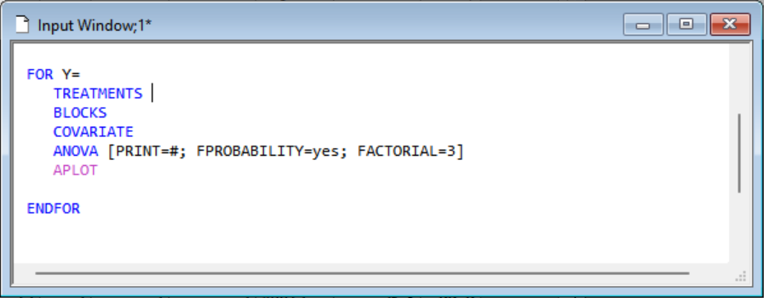
Insert code snippets

Slide 51
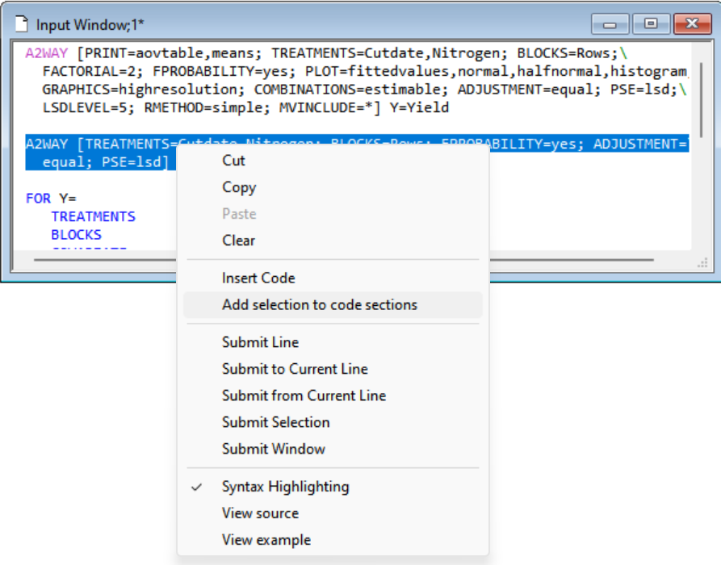
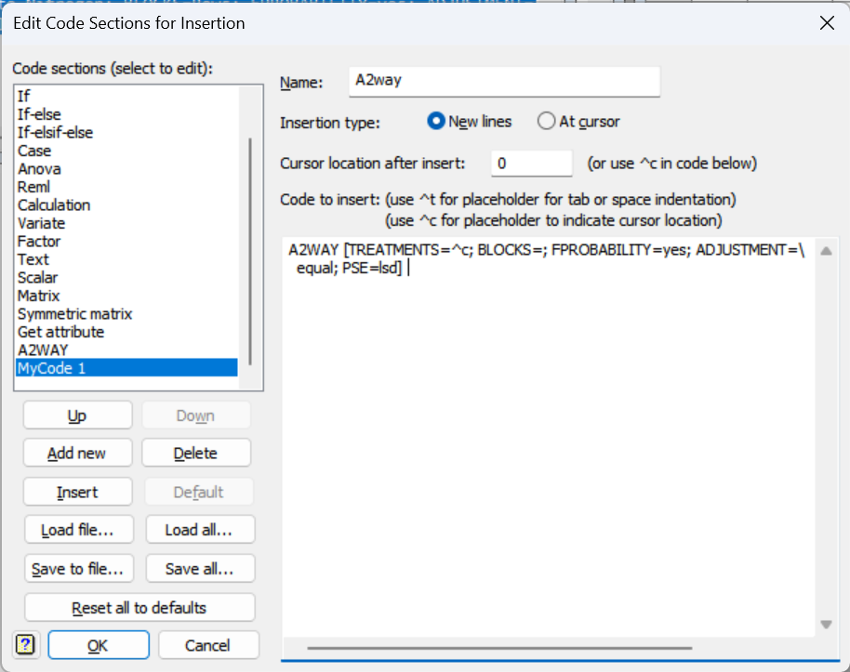
Create code snippets

Slide 52

New Reshape menu
Reorder rows and columns
Form summaries across factors
Example Soil DDT measurements on long term irrigation trial

Slide 53


New Reshape menu

Slide 54

New Reshape menu

Slide 55


Excel Reading Colours & Formulae
Read in colours from Excel – sometimes these are used by clients to hold information – outliers or status
Read in formulae to check for inconsistencies
Keep Excel cell colours in spreadsheet display

Slide 56


Excel formulae

Slide 57

Two skew distributions added
Skew Normal with skewness parameter alpha
Pdf(x) = 2*PRNORMAL((x-m)/s)*CLNORMAL(α(x-m)/s)
Added to GRANDOM for random numbers
DPROBABILITY for display and estimation by MLE

Slide 58

Exponentially modified Normal
Sum of Normal(m,s) and Exponential(r) variables
Added to GRANDOM for random numbers
DPROBABILITY for display and estimation by MLE

Slide 59
Linux version of Genstat 23
Server complete
Working on graphics -> PNG or PDF
Batch mode only
Will run in the cloud

Slide 60

Updates from Genstat course
Random Forest menus
Nearest neighbour cluster menu
Likelihood Tests for fixed and random effects in GLMM and HGLM menus
Tests for negative variance components
HGLM menu option to automatically select canonical links and conjugate distributions

Slide 61
Suggestions for Genstat 23/4
Output + graphs -> PDF
Code formatter
Mosaic plots
New functions ??
Suggestions

